Slide 1
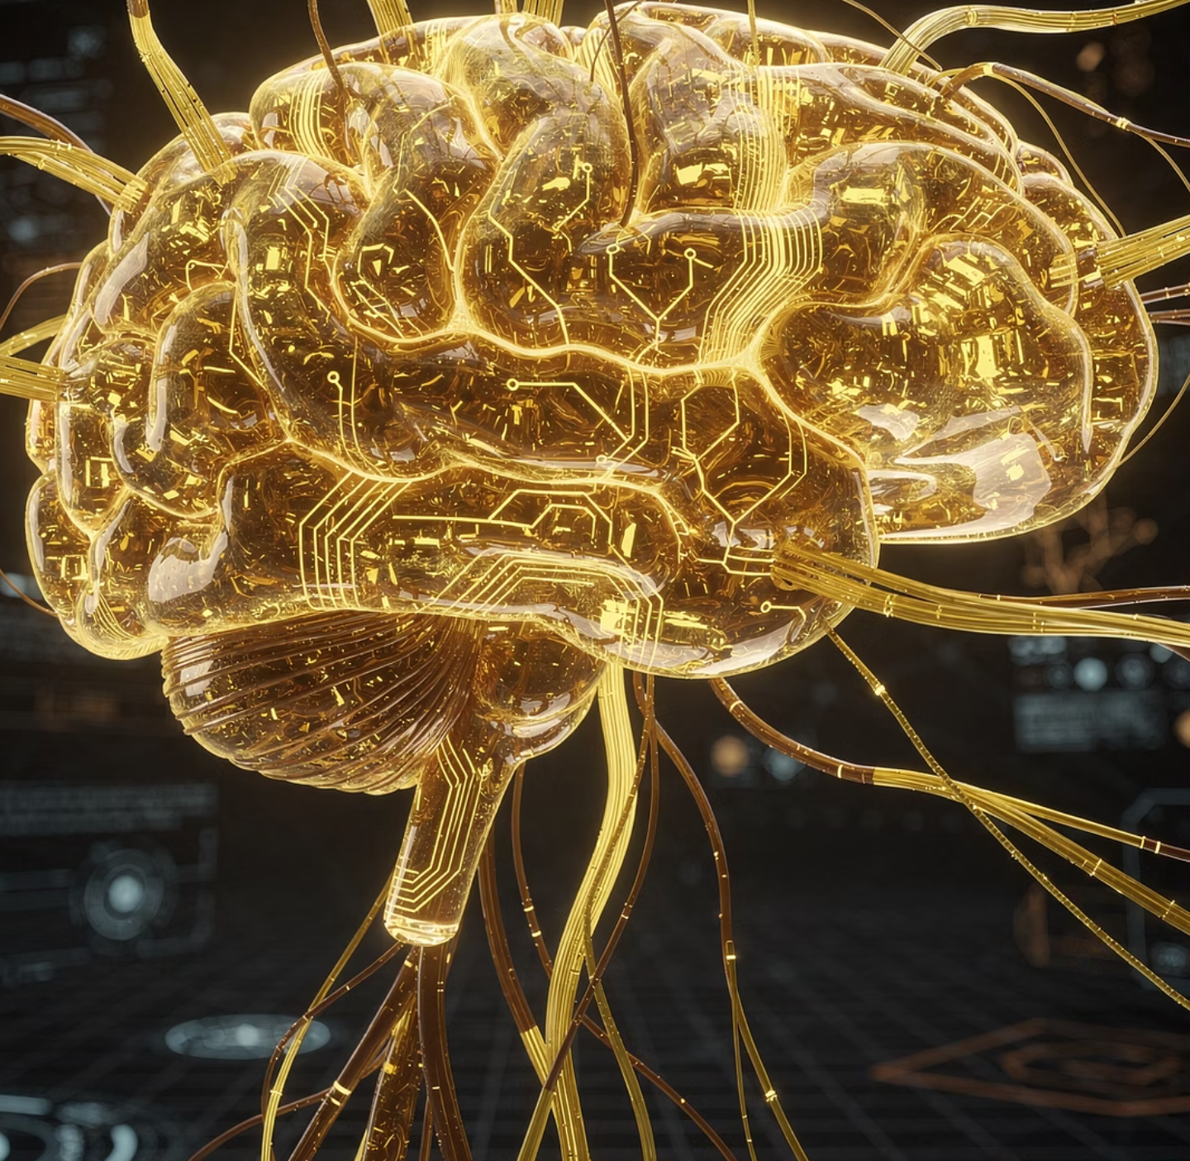

CHATAKE INNOWORKS
JIGYASA BY MINDFORGEAI
JIGYASA / MINDFORGEAI LEARN
GUEST LECTURE
Machine Learning
in the Age of AI
Machine Learning
in the Age of AI
Equations. Data. Models. Decisions.
Akash Chatake
Akash Chatake · Machine Learning in the Age of AI
01
Notes:
Open BabyX First Words before this slide: https://vimeo.com/103501130. Official university lab film; internet required. The rest of the core demonstration is local.

Slide 2

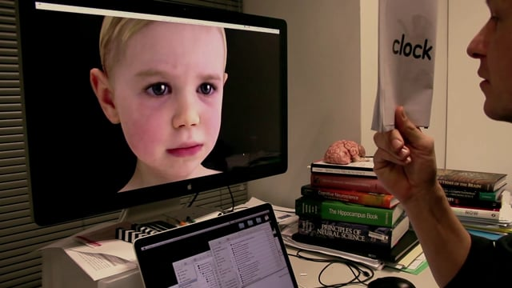
CHATAKE INNOWORKS
JIGYASA / MINDFORGEAI LEARN
BABYX OPENER
Learning, interaction and appearance
SENSE
UPDATE
What enters the system?
What changes with experience?
BabyX First Words
Watch the linked lab film, then distinguish a convincing response from evidence of understanding.
Akash Chatake · Machine Learning in the Age of AI
02
Notes:
Film source: Laboratory for Animate Technologies, University of Auckland: https://vimeo.com/103501130. Ask what is sensed, designed and learned. Poster source: Vimeo oEmbed thumbnail for BabyX First Words, Lab for Animate Technologies.

Slide 3
CHATAKE INNOWORKS
JIGYASA / MINDFORGEAI LEARN
ROADMAP
One experiment, from equation to prediction
Equation
→
Observe
→
Train
→
Check
→
Predict
The same learning loop reappears in larger ML systems.
Akash Chatake · Machine Learning in the Age of AI
03
Notes:
Explain the full lifecycle before the calculations. Fitting is training in this parameter-estimation example. All observations are synthetic.

Slide 4
CHATAKE INNOWORKS
JIGYASA / MINDFORGEAI LEARN
DIFFERENTIAL EQUATION
A cooling model with one unknown
dT/dt = −k(T − 25)
T(t) = 25 + 55 exp(−kt)
25°C
80°C
k = ?
Room temperature
Initial temperature
Rate learned from data
Akash Chatake · Machine Learning in the Age of AI
04
Notes:
Newton cooling assumes constant room temperature and effective cooling coefficient. This is a synthetic illustration. t is minutes, k is per minute. Equation: dT/dt=-k(T-25), T(0)=80.

Slide 5
CHATAKE INNOWORKS
JIGYASA / MINDFORGEAI LEARN
SYNTHETIC OBSERVATIONS
Observed data constrains the equation
7 observations
The equation is fixed.
The rate k is still unknown.
Separate training observations from later held-out checks.
Akash Chatake · Machine Learning in the Age of AI
05
Notes:
Seven training observations at 0–30 minutes. Data are synthetic and intentionally noisy. Held-out temperatures at 35 and 40 minutes are not used to fit k.

Slide 6
CHATAKE INNOWORKS
JIGYASA / MINDFORGEAI LEARN
PARAMETER ESTIMATION
Fitting is training this model
Choose k
→
Predict T
→
Measure error
→
Update k
Loss = mean of (prediction − observation)²
The computer changes k repeatedly; the learner specifies the model and objective.
Akash Chatake · Machine Learning in the Age of AI
06
Notes:
Fitting and training both refer here to choosing k to minimise training MSE. Start k=.015 per minute. Gradient descent optimises log(k), learning rate .001, 180 updates.

Slide 7
CHATAKE INNOWORKS
JIGYASA / MINDFORGEAI LEARN
TRAINING RESULT
The fitted curve follows the observations
k ≈ 0.03979
per minute
A parameter learned from seven observations.
Training error alone does not establish future performance.
Akash Chatake · Machine Learning in the Age of AI
07
Notes:
Actual values calculated by retained Python builder. Initial k=.015, final k=0.03978592 per minute. MSE decreases from 175.46056 to 0.09379 °C².

Slide 8
CHATAKE INNOWORKS
JIGYASA / MINDFORGEAI LEARN
LEARNING HISTORY
Training reduces the stated loss
175.46 → 0.094
Training MSE in °C²
Same observations, better parameter.
An improving training curve is evidence of optimisation; an unseen check asks a different question.
Akash Chatake · Machine Learning in the Age of AI
08
Notes:
The plotted loss is training MSE from the deterministic gradient descent run, not test performance. Display every tenth update.

Slide 9
CHATAKE INNOWORKS
JIGYASA / MINDFORGEAI LEARN
HELD-OUT CHECK
A check on two later observations
0.133°C
Mean absolute error on two held-out synthetic observations.
A small synthetic check demonstrates the method; real use needs more varied data.
Akash Chatake · Machine Learning in the Age of AI
09
Notes:
35-minute actual=38.4°C, predicted=38.665°C. 40-minute actual=36.2°C, predicted=36.2°C. Mean absolute error 0.133°C. Tiny synthetic check, not an operational validation study.

Slide 10
CHATAKE INNOWORKS
JIGYASA / MINDFORGEAI LEARN
INFERENCE
A prediction at a new time
t = 45 minutes
25 + 55 exp(−0.03978592 × 45)
≈ 34.18°C
Inference substitutes a new input into the fitted equation; changing k would be additional training.
Akash Chatake · Machine Learning in the Age of AI
10
Notes:
45 minutes lies beyond the 0–30 minute training range, so this is extrapolation under the same cooling assumptions. No observed 45-minute value is supplied to the model.

Slide 11

CHATAKE INNOWORKS
JIGYASA / MINDFORGEAI LEARN
LIMITS
The assumptions travel with the prediction
What if the cup changes?
The fitted rate may change.
A good fit does not protect against a different physical setup.
Physics, data quality and evaluation are part of the same engineering problem.
Akash Chatake · Machine Learning in the Age of AI
11
Notes:
Discuss changing room temperature, vessel, contents and measurement accuracy. Extrapolation and physical validity are distinct from low training error.

Slide 12
CHATAKE INNOWORKS
JIGYASA / MINDFORGEAI LEARN
CAMPUS-ENERGY CASE
Data and exploratory analysis
600 cases
Units · missingness · ranges
Timing · duplicates · provenance
The data dictionary comes before the model; transformations are fitted on training data only.
Akash Chatake · Machine Learning in the Age of AI
12
Notes:
Switch from cooling data to separate 600-row synthetic campus dataset. These are independent fictional scenarios, not a real campus time series.

Slide 13
CHATAKE INNOWORKS
JIGYASA / MINDFORGEAI LEARN
LEARNING TASKS
The task determines the output
Regression
Classification
How many kWh?
High demand or normal?
Clustering
Forecasting
Which patterns are similar?
What comes next?
Generation creates text or media and requires its own evaluation.
Akash Chatake · Machine Learning in the Age of AI
13
Notes:
Regression predicts a number; classification predicts a category/probability; clustering groups without labelled outcomes; forecasting respects temporal order; generation produces content.

Slide 14
CHATAKE INNOWORKS
JIGYASA / MINDFORGEAI LEARN
SUPERVISED MODELS
Linear and logistic regression
y = w₀ + w₁x
Linear: a numeric estimate
Logistic: a class probability
Both learn weights from labels.
A simple baseline makes later improvements meaningful.
Akash Chatake · Machine Learning in the Age of AI
14
Notes:
Left is an illustrative linear relationship, not empirical evidence. Logistic regression estimates class probability. The final decision threshold is separate.

Slide 15
CHATAKE INNOWORKS
JIGYASA / MINDFORGEAI LEARN
SUPERVISED MODELS
KNN and SVM use geometry differently
?
KNN · nearby labelled cases
SVM · a separating margin
Distance and margins depend on representation, units and kernel choices.
Akash Chatake · Machine Learning in the Age of AI
15
Notes:
Native editable conceptual diagrams; points are schematic, not model results. KNN looks at neighbours. SVM chooses a separating margin. Feature scaling matters.

Slide 16
CHATAKE INNOWORKS
JIGYASA / MINDFORGEAI LEARN
DECISION RULES
Trees and ensembles
Hours > 8?
Occupancy > 150?
Area > 400?
A tree splits feature space
Forest: combine trees
XGBoost: correct error in stages
Tuning and leakage can still produce an invalid result, even with a strong algorithm.
Akash Chatake · Machine Learning in the Age of AI
16
Notes:
Conceptual editable tree. Random forest combines many trees; XGBoost builds boosted trees sequentially. This is a schematic, not a fitted campus tree.

Slide 17

CHATAKE INNOWORKS
JIGYASA / MINDFORGEAI LEARN
UNSUPERVISED LEARNING
K-means groups unlabelled examples
The method groups by distance; a person explains whether those groups are useful.
Akash Chatake · Machine Learning in the Age of AI
17
Notes:
Conceptual native cluster diagram. K must be chosen; clusters are not ground truth classes. Owner-provided Unit 5 illustration is a visual metaphor only.

Slide 18
CHATAKE INNOWORKS
JIGYASA / MINDFORGEAI LEARN
NEURAL ARCHITECTURE
LSTM carries state through a sequence
t − 2
t − 1
t
t + 1
LSTM cell
→
LSTM cell
→
LSTM cell
→
Prediction
Gated memory passes between ordered steps
Sequence construction, history length and future-data leakage matter more than the model name.
Akash Chatake · Machine Learning in the Age of AI
18
Notes:
Editable sequence diagram. An LSTM is a gated recurrent architecture. Compare against seasonal or simple baselines and evaluate on later periods. The campus scenarios are not sequence data.

Slide 19
CHATAKE INNOWORKS
JIGYASA / MINDFORGEAI LEARN
NEURAL ARCHITECTURE
Transformers relate tokens through attention
The
motor
is
hot
A token representation uses information from other tokens.
The full system also includes training data, objectives, tuning, evaluation and deployment.
Akash Chatake · Machine Learning in the Age of AI
19
Notes:
Attention diagram is conceptual, not measured attention weights. Transformer paper: https://arxiv.org/abs/1706.03762. GPT/Gemini refer to product/model families, not individual classical learning algorithms.

Slide 20
CHATAKE INNOWORKS
JIGYASA / MINDFORGEAI LEARN
METHOD AND ARCHITECTURE
A map of the model names
KNN / SVM
Supervised methods
K-means
Unsupervised clustering
XGBoost
Boosted-tree implementation
LSTM / transformer
Neural architectures
GPT / Gemini
Foundation-model families
Akash Chatake · Machine Learning in the Age of AI
20
Notes:
KNN/SVM supervised methods; K-means unsupervised clustering; XGBoost boosted-tree implementation; LSTM sequence architecture; transformers architecture; GPT/Gemini model families. They are not an intelligence ladder.

Slide 21
CHATAKE INNOWORKS
JIGYASA / MINDFORGEAI LEARN
CAMPUS-ENERGY VALIDATION
Evaluation starts with a fair comparison
Same cases
Same metric
Only advance inputs
A separate held-out test
These synthetic results do not establish real-campus performance.
Akash Chatake · Machine Learning in the Age of AI
21
Notes:
Frozen synthetic validation comparison: mean baseline 19.53 kWh MAE vs allowed-input linear model 7.46. Same 120 validation cases. Test remains separate.

Slide 22
CHATAKE INNOWORKS
JIGYASA / MINDFORGEAI LEARN
LEAKAGE INVESTIGATION
The perfect score exposes a timing error
0.0
End-of-day meter
= the outcome copied after the day
kWh validation MAE
Remove the feature, retrain and audit availability at prediction time.
Akash Chatake · Machine Learning in the Age of AI
22
Notes:
The planted end_of_day_meter_kwh equals the outcome and is known too late. Show leaked model on local website.

Slide 23
CHATAKE INNOWORKS
JIGYASA / MINDFORGEAI LEARN
CLASSIFICATION DECISIONS
A label and an alert threshold
125 kWh
0.30 probability
Observed boundary
Defines the target class.
Decision boundary
Triggers an illustrative alert.
Precision, recall and error costs explain the decision better than accuracy alone.
Akash Chatake · Machine Learning in the Age of AI
23
Notes:
Observed demand ≥125kWh defines high-demand label. 0.3 is a selected probability threshold under an illustrative cost assumption of 5 per missed event,1 per false alarm.

Slide 24

CHATAKE INNOWORKS
JIGYASA / MINDFORGEAI LEARN
REAL-LIFE EXAMPLES
Applications are decisions in context
Retail
Stock forecasts → replenishment
Factory
Vibration anomaly → technician review
Healthcare
Risk estimate → validated clinical review
Support
Triage and draft → verified response
Akash Chatake · Machine Learning in the Age of AI
24
Notes:
Illustrative applications; no claim of clinical or field validation. Owner-provided photo from college Unit 3 is a visual concept.

Slide 25
CHATAKE INNOWORKS
JIGYASA / MINDFORGEAI LEARN
TRAINING AT SCALE
How a foundation model is developed
Pretraining
→
Further tuning
→
Evaluation
→
Deployment
Training objective, data, tuning and system tools all influence observed behaviour.
Akash Chatake · Machine Learning in the Age of AI
25
Notes:
High-level typical stages only; exact proprietary recipes may not be public. Source official model cards: https://deepmind.google/models/model-cards/ and https://developers.openai.com/api/docs/models.

Slide 26
CHATAKE INNOWORKS
JIGYASA / MINDFORGEAI LEARN
AS OF 17 OCTOBER 2026
Current model examples
GPT-6 Astra
Gemini 4 Argon
A product name or version number is not an intelligence metric. Read its model card and limits.
Akash Chatake · Machine Learning in the Age of AI
26
Notes:
Verified official catalogues: https://developers.openai.com/api/docs/models lists GPT-6 Astra and GPT-6.1 Sol. https://deepmind.google/models/model-cards/ lists Gemini 4 Argon. No universal ranking is asserted.

Slide 27
CHATAKE INNOWORKS
JIGYASA / MINDFORGEAI LEARN
BENCHMARKS
What a model score actually measures
90 / 100
A score needs context
Dataset and task
Metric and denominator
Date and test conditions
on which questions?
Benchmark success does not certify a different local workflow.
Akash Chatake · Machine Learning in the Age of AI
27
Notes:
Illustrative 90/100 is an arithmetic example only, not a real model result. Ask which task, dataset, metric, date and conditions. Provider reports and independent reproduction differ.

Slide 28
CHATAKE INNOWORKS
JIGYASA / MINDFORGEAI LEARN
RELIABILITY
Hallucinations and factual checks
“The paper proves 100% accuracy.”
Can we open the paper and find that claim?
Source inspection → evidence → review
Fluency and confidence in wording do not establish factual correctness.
Akash Chatake · Machine Learning in the Age of AI
28
Notes:
Fabricated citation shown as a deliberate fictional example, not a real source. Verify source text and arithmetic. Retrieval may reduce unsupported output but does not guarantee truth.

Slide 29
CHATAKE INNOWORKS
JIGYASA / MINDFORGEAI LEARN
SYSTEM DESIGN
Agentic AI is a controlled tool loop
Goal
→
Plan
→
Tool
→
Observe
→
Revise
Permissions · state · checks · stop rules · human approval
A written plan is one component of a working agent system.
Akash Chatake · Machine Learning in the Age of AI
29
Notes:
Conceptual editable loop: goal, plan, tool, observe, revise. Harmless demo reads synthetic CSV, counts missing entries, drafts report, asks for approval. Tools need explicit permissions and stop rules.

Slide 30

CHATAKE INNOWORKS
JIGYASA / MINDFORGEAI LEARN
TASKS AND ACCOUNTABILITY
Engineering work in the age of AI
AI can assist with tasks
Draft code and reports
Inspect data and suggest tests
Repeat bounded workflows
Engineers frame the problem, verify the evidence and remain responsible for deployment.
Akash Chatake · Machine Learning in the Age of AI
30
Notes:
Do not imply inevitable job replacement. Discuss bounded assistance, verification, system integration and accountability. Illustration, if used, is generated editorial concept.

Slide 31
CHATAKE INNOWORKS
JIGYASA / MINDFORGEAI LEARN
OUR ECOSYSTEM
Project demonstrations
MindForgeAI
13-project catalogue
Apollo ABS-100
Reference engineering assembly
GFIS Upgrade
Simulation and evidence workflow
MLOps Academy
Versioning, deployment and monitoring
Akash Chatake · Machine Learning in the Age of AI
31
Notes:
Use project routes on learner page. Apollo ABS-100 is a reference assembly, GFIS Upgrade a simulation, AI Deception Lab bounded synthetic events. No clinical/physical validation is inferred.

Slide 32
CHATAKE INNOWORKS
JIGYASA / MINDFORGEAI LEARN
STUDENT ROADMAP
Your next experiment
Frame
→
Inspect
→
Fit
→
Evaluate
→
Explain
One small model, an honest test and a clear limitation
Continue with the notebook, printed notes and Workshop 01.
Akash Chatake · Machine Learning in the Age of AI
32
Notes:
Exit task: decision, prediction time, target, two usable inputs, baseline, metric, likely failure and human reviewer. Learner page includes cooling notebook and CSV plus campus notebooks.

