Slide 1
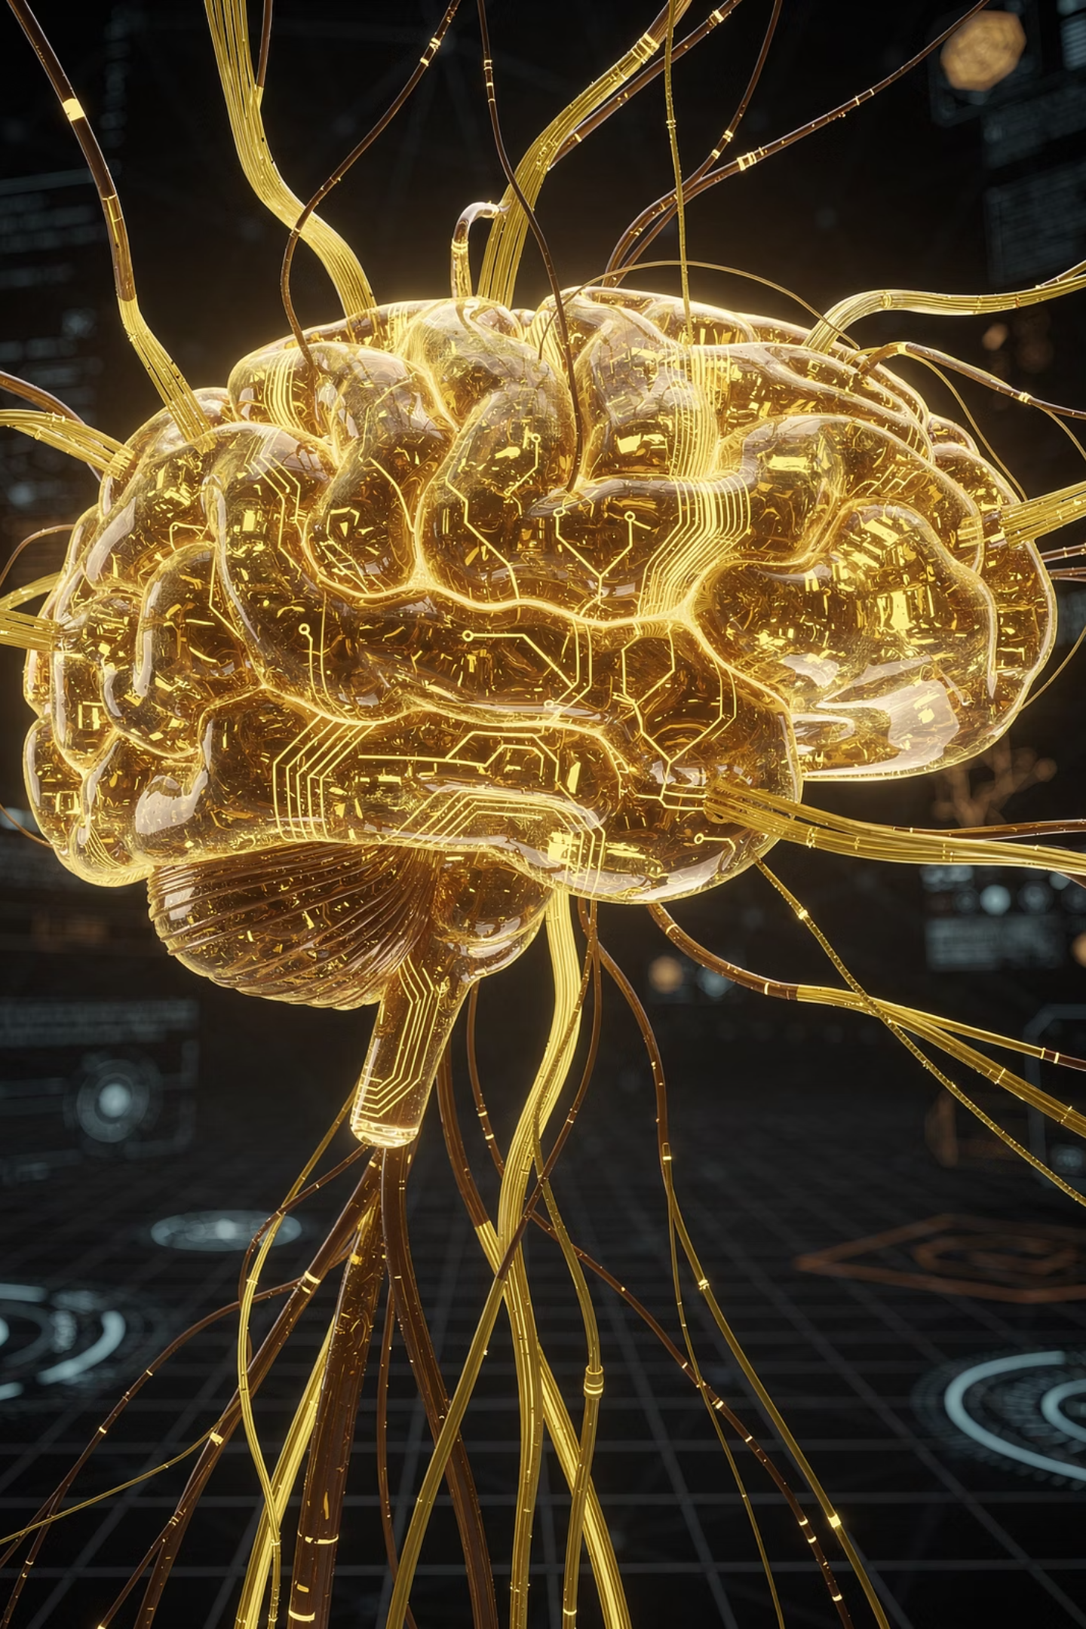
Introduction to Machine Learning
A comprehensive guide to understanding machine learning fundamentals, types, applications, and Python implementation for diploma-level students.

Slide 2
Unit 1 Overview
01
02
Basics of ML
Types of ML
Definition, Traditional Programming vs ML, Role in AI/DS
Supervised, Unsupervised, Reinforcement Learning
03
04
Applications & Challenges
Python for ML
Real-world use cases, challenges
Python basics, libraries, simple scripts
Total Learning Time: 8 hours | Exam Weight: ~25% of first semester

Slide 3

What is Machine Learning?
Simple Definition
Why ML Matters
Machine Learning is a method of making computers learn patterns from data and improve their performance automatically, without being explicitly programmed for every scenario.
Too Complex to Code: Can't write rules for face recognition or movie recommendations
Data is Abundant: Modern world generates massive amounts of data that ML can use
Instead of writing rules manually, we show the computer examples and it learns the patterns on its own.
Systems Need to Adapt: ML models learn and update automatically to handle changing conditions

Slide 4
Traditional Programming vs Machine Learning
Aspect
Traditional Programming
Machine Learning
How it works
Programmer writes explicit rules → Computer executes code
Programmer shows examples → Computer learns rules automatically
Input to system
Input data
Input data + expected output (examples)
Process
Code execution
Learning from data
Can it adapt?
No - needs reprogramming
Yes - learns from new data
Best for
Well-defined problems (banking, billing)
Pattern recognition (face detection, recommendations)

Slide 5

Email Spam Filter: A Real-World Example
Traditional Approach
Write thousands of rules manually: "If contains 'free money' → Mark as SPAM"
Problem: Spammers change text, all rules break
ML Approach
Show system 10,000 spam emails + 10,000 legitimate emails
System learns patterns automatically and adapts when spammers change tactics

Slide 6




ML's Role in AI and Data Science
Machine Learning
A tool within AI that enables systems to learn from data
Artificial Intelligence
Broad field of creating intelligent machines including robotics, planning, and decision-making
Data Science
Uses data to extract insights combining statistics, programming, and domain knowledge
Machine Learning serves as a key component bridging AI capabilities with Data Science methodologies.

Slide 7
Three Key Components of ML Systems
DATA
MODEL
LEARNING ALGORITHM
Raw information/facts like student marks, images, customer records
Mathematical structure that learns patterns - like an empty vessel that "learns" from data
Step-by-step procedure to teach the model by showing data, calculating error, and improving
Key principle: Quality > Quantity
Examples: Decision Tree, Linear Regression, Neural Network
Examples: Gradient Descent, k-means
How they work together: DATA → [LEARNING ALGORITHM] → MODEL → Can predict new data

Slide 8




Three Key Processes in ML
TRAINING
VALIDATION
TESTING
Teach the model using 60-80% of data. Show examples with correct answers. Duration: Hours to weeks.
Check if model is learning well using 10-20% of data. Test on unseen data during training to tune parameters.
Final evaluation using 20% of data never seen during training. Tells us real-world performance.

Slide 9

Supervised Learning
Definition
Learning from labeled examples where both input AND correct output are provided.
How It Works
Input Data (Features) fed to Model
Model makes Prediction
Compare with ACTUAL LABEL
Calculate Error
Adjust Model
Repeat until accurate
Requirements
Labeled data (input-output pairs)
Clear definition of what to predict
Usually 100s to 1000s of examples

Slide 10
Classification vs Regression
CLASSIFICATION
REGRESSION
Predict Categories
Predict Numbers
Email: Spam or Not Spam? (2 categories)
House price (e.g., ₹45,00,000)
Disease: Present or Absent?
Temperature tomorrow (e.g., 28°C)
Handwritten digit: 0, 1, 2, …, 9? (10 categories)
Student GPA (e.g., 3.8)
Student: Pass or Fail?
Stock price next week (e.g., ₹1,250)
Fruit: Apple, Orange, Banana?
Age of person from photo (e.g., 35 years)
Output: Discrete category (not continuous number)
Output: Any continuous number within range

Slide 11

Supervised Learning: Pros and Cons
Advantages
Disadvantages
Clear feedback (know if prediction is right/wrong)
Requires labeled data (expensive and time-consuming)
Usually high accuracy
Can't use unlabeled data (most real-world data is unlabeled)
Well-established methods
Models can memorize instead of learning (overfitting)
Real-World Applications
Medical diagnosis
Credit approval
Spam detection
Student grade prediction

Slide 12

Unsupervised Learning
Finding hidden patterns and structure in data WITHOUT labels or expected outputs.
1
Raw Data (No Labels)
2
Algorithm Discovers Patterns
3
Groups or Structures
4
Human Interprets Results

Slide 13



Clustering: Grouping Similar Items
Document Grouping
Categorize news articles: Sports cluster, Political cluster, Business cluster
Customer Segmentation
Group customers by shopping behavior: Budget buyers, Premium buyers, Occasional buyers
Image Clustering
Group similar photos: All dog photos, All cat photos, All bird photos
How it works: Algorithm measures similarity between items, groups similar items together, and humans interpret what each cluster means.

Slide 14
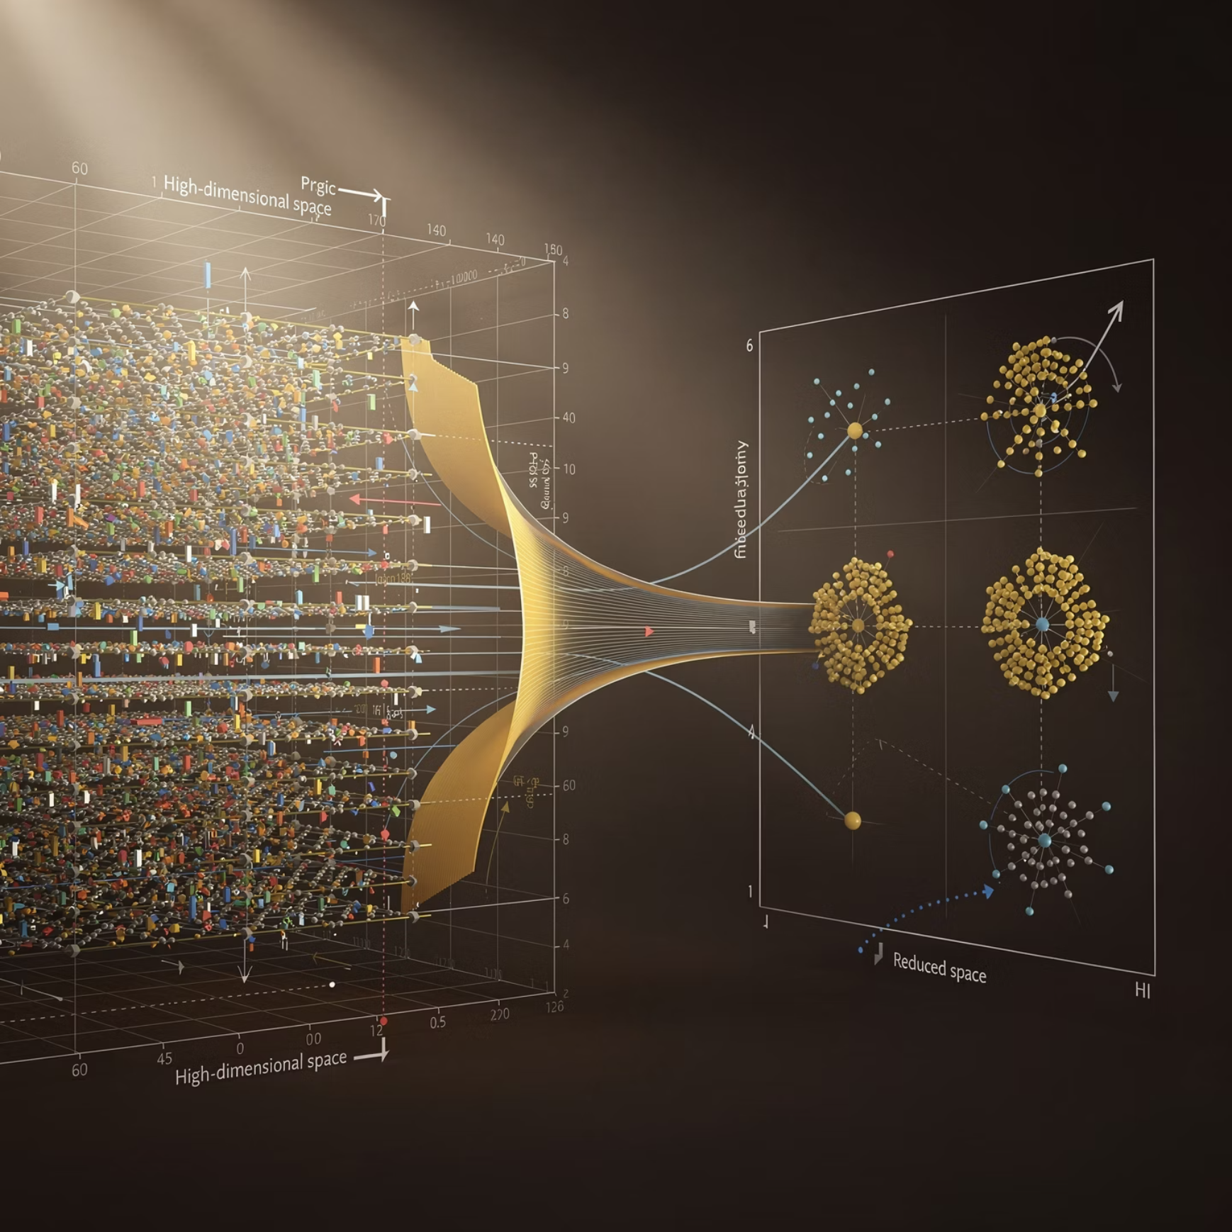
Dimensionality Reduction
Definition
Why Useful?
Reduce number of features while keeping important information - like compressing a photo to a smaller file while maintaining the same content.
Faster model training
Easier to visualize
Examples
Less storage needed
Sensor data: 1000 sensors → Compress to 10 important values
Removes irrelevant features
Visualizing data: High-dimension data → 2D plot
Removing noise: Keep important patterns, remove noise
Data compression: Store less data, faster processing

Slide 15
Unsupervised Learning: Pros and Cons
Advantages
Disadvantages
No need for labels (huge advantage!)
Hard to validate results (no "correct" answer)
Works with abundant unlabeled data
May find meaningless patterns
Discovers unexpected patterns
Requires human interpretation
Cheaper than supervised learning
Results can be unpredictable
Real-World Applications: Customer segmentation for targeted marketing, Document recommendation systems, Gene clustering in biological research, Anomaly detection, Social network analysis

Slide 16




Reinforcement Learning
Learning through interaction and rewards - agent learns best actions by trial-and-error.
Agent Takes Action
Environment Responds
Learns & Improves Strategy
Receives Reward/Penalty

Slide 17



Training a Dog: RL Example
Iteration 1
Dog jumps on sofa (Action) → Owner scolds (Negative reward: -1) → Dog learns: "Jumping = bad"
Iteration 2
Dog lies down (Action) → Owner gives treat (Positive reward: +1) → Dog learns: "Lying down = good"
After Many Iterations
Dog has learned optimal policy: "Lie down to get rewards"

Slide 18
RL Applications & Trade-offs
Real-World Applications
Advantages
Game Playing: AlphaGo, Video game agents, Chess engines
Works in complex, dynamic environments
Robotics: Robot arm learning to pick objects, Walking/balance learning, Navigation
Can learn optimal long-term strategies
No need for labeled data
Autonomous Systems: Self-driving cars, Trading systems, Resource allocation
Disadvantages
Requires many interactions (slow learning)
Dangerous in real-world (learning by failure)
Hard to design good reward system

Slide 19
Comparing Three Types of ML
Aspect
Supervised
Unsupervised
Reinforcement
Data Required
Labeled (input + output)
Unlabeled data only
Reward signals
Learning Style
With teacher
Self-discovery
Trial-and-error
Feedback
Immediate (right/wrong)
None (human interprets)
Reward/penalty
Typical Tasks
Classify, predict values
Group, compress data
Optimize actions
Example
Email spam filter
Customer segmentation
Game-playing AI

Slide 20
ML Applications Across Industries
Healthcare
Finance
Disease diagnosis from X-rays, drug discovery, treatment planning, patient risk prediction. ML analyzes chest X-rays to detect tuberculosis with 95% accuracy.
Credit risk assessment, fraud detection, stock price prediction, customer credit scoring. ML systems detect unusual spending patterns and block fraudulent transactions.
E-Commerce
Transportation
Product recommendations, price optimization, customer segmentation, demand forecasting. Amazon recommends products based on browsing history.
Self-driving cars with autonomous navigation, route optimization for delivery, traffic prediction systems.

Slide 21

Challenge 1: Data Quality
The Problem
Solution
"Garbage in, garbage out"
Data cleaning and validation
Incomplete data (missing values)
Handle missing values
Incorrect data (errors in recording)
Remove outliers
Inconsistent data (different formats)
Ensure representative sample
Biased data (not representative)
Impact
Poor data → Poor model, regardless of algorithm quality

Slide 22
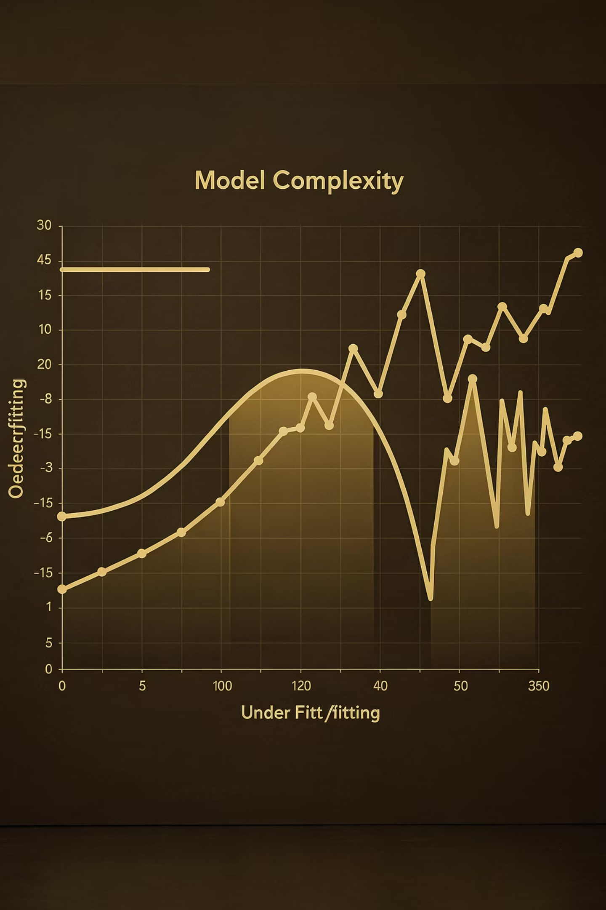
Challenge 2: Overfitting vs Underfitting
OVERFITTING
Problem: Model learns training data too well (including noise) and memorizes examples
Example: Training accuracy: 99%, Test accuracy: 60%
Solution: Use more training data, simpler model, early stopping, regularization
UNDERFITTING
Problem: Model too simple to learn underlying patterns, fails on both training and test data
Example: Training accuracy: 65%, Test accuracy: 62%
Solution: More complex model, more features, longer training

Slide 23
Challenge 3: Bias in Data
Training data doesn't represent entire population, leading to discriminatory models.
1
2
3
Historical Bias
Sampling Bias
Measurement Bias
Past discrimination encoded in data
Data not representative of population
Systematic errors in data collection
Example: Trained on faces of one ethnicity → performs poorly on others. Trained on male-dominated hiring data → discriminates against women.
Solution: Diverse training data, fairness metrics, regular audits, remove biased features

Slide 24
Ethical Concerns in ML
Privacy
Transparency
Training data may contain personal information. Facial recognition can invade privacy.
"Black box" models are hard to explain. Users deserve to understand decisions.
Fairness
Accountability
Models may discriminate against certain groups. Loan approval algorithms can be biased.
Who's responsible if model makes wrong decision? Clear ownership needed.
Solution: Ethical guidelines, transparency requirements, privacy-preserving techniques, regular bias audits

Slide 25

Why Python for Machine Learning?
Easy to Learn and Read
Simple syntax that resembles natural language, making it accessible for beginners
Rich Ecosystem of ML Libraries
Comprehensive libraries like NumPy, Pandas, Scikit-learn, and TensorFlow
Wide Community Support
Large community providing tutorials, documentation, and solutions
Industry Standard
Used by leading companies and researchers worldwide for ML and Data Science

Slide 26




Essential Python Libraries for ML
NumPy
Pandas
Matplotlib
Scikit-learn
Purpose: Numerical computing with arrays
Purpose: Data manipulation
Purpose: Data visualization
Purpose: Machine Learning
Work with tabular data like Excel spreadsheets. Load, clean, explore, and transform data efficiently.
Create charts and graphs including line plots, bar charts, histograms, and scatter plots.
Build ML models easily with classification, regression, clustering algorithms and evaluation tools.
Work with numerical arrays, matrix operations, mathematical functions. Essential for scientific computing.

Slide 27
Python Basics: Variables and Data Types
Lists (Collections)
# Numbers
age = 25 # Integer
height = 5.9 # Float
price = 1000.50 # Float
# Strings
name = "Alice" # String
city = 'Mumbai' # Single or double quotes
# Booleans
is_student = True # True or False
has_loan = False
# Print values
print(age) # Output: 25
print(name) # Output: Alice
# Create list
marks = [85, 90, 78, 92, 88]
students = ["Alice", "Bob", "Charlie"]
# Access elements (0-indexed)
print(marks[0]) # Output: 85
print(students[1]) # Output: Bob
# Add to list
marks.append(95) # Add at end
marks.insert(0, 80) # Add at position 0
# List length
print(len(marks)) # Output: 6

Slide 28
Simple ML Script: Classification Model
# Step 1: Import libraries
import pandas as pd
from sklearn.model_selection import train_test_split
from sklearn.tree import DecisionTreeClassifier
from sklearn.metrics import accuracy_score
# Step 2: Load data
data = {
'Age': [20, 25, 30, 35, 40, 45],
'Income': [30000, 40000, 50000, 60000, 70000, 80000],
'BuysProduct': [0, 0, 1, 1, 1, 1] # 0=No, 1=Yes
}
df = pd.DataFrame(data)
# Step 3: Prepare data
X = df[['Age', 'Income']] # Features
y = df['BuysProduct'] # Target
# Step 4: Split data
X_train, X_test, y_train, y_test = train_test_split(
X, y, test_size=0.3, random_state=42
)
# Step 5: Create and train model
model = DecisionTreeClassifier(max_depth=3)
model.fit(X_train, y_train)
# Step 6: Make predictions
predictions = model.predict(X_test)
print(f"Predictions: {predictions}")
# Step 7: Evaluate
accuracy = accuracy_score(y_test, predictions)
print(f"Model Accuracy: {accuracy:.2f}")

Slide 29
Typical ML Workflow
Data Collection
Gather relevant data from various sources
Data Cleaning & Preparation
Handle missing values, remove errors, format consistently
Exploratory Analysis
Visualize and understand data patterns
Split Data
Train (80%) / Test (20%)
Choose & Train Model
Select algorithm and train on training data
Predict & Evaluate
Test on unseen data and calculate accuracy
Deployment
Use model in real-world applications

Slide 30

Key Takeaways: Unit 1 Summary
ML Fundamentals
Three Types of ML
ML learns patterns from data automatically
Supervised: Labeled data → Classification/Regression
Three components: Data, Model, Learning Algorithm
Unsupervised: Unlabeled data → Clustering/Reduction
Three phases: Training, Validation, Testing
Reinforcement: Rewards → Optimal policy
Challenges
Python for ML
Data quality matters most
NumPy, Pandas, Matplotlib, Scikit-learn
Overfitting vs Underfitting
Simple syntax and rich libraries
Bias and ethical concerns
Industry standard for ML/Data Science
Computational resources
Total Study Time: 4 hours recommended | Exam Weight: ~25% of first semester

