Slide 1

Data Preprocessing
A comprehensive guide to transforming raw data into clean, structured formats for machine learning applications

Slide 2
Course Information
Unit II: Data Preprocessing
Course Details
Publication
MSBTE K-Scheme Syllabus
MindforgeAi Publications
Course Code: 316316
Technical Publication Series
Semester: 6
Chatake Innoworks Pvt. Ltd.
Subject: Machine Learning
Authored by: Akash Chatake

Slide 3
What is Data Preprocessing?
Data preprocessing transforms raw data into a clean, structured format suitable for machine learning algorithms. It involves cleaning, normalizing, transforming, and reducing data to improve model accuracy and performance.
Raw Data
Clean Data
Structured Data
Data collected from various sources in its original, unprocessed form
Data processed to remove errors, inconsistencies, and irrelevant information
Data organized in a format suitable for analysis and machine learning

Slide 4

Why Data Preprocessing Matters
Improves Model Accuracy
Clean data leads to better model performance and more reliable predictions
Reduces Training Time
Efficient preprocessing speeds up model training and optimization
Handles Real-World Data
Real data is often messy, incomplete, and requires careful preparation
Prevents Overfitting
Proper preprocessing helps models generalize better to new data

Slide 5






The Data Preprocessing Pipeline
A systematic approach to transforming raw data into machine learning-ready datasets
Data Collection
Gathering data from various sources
Data Exploration
Understanding data structure and patterns
Data Cleaning
Handling missing values, duplicates, and outliers
Data Transformation
Normalization, encoding, and feature scaling
Data Reduction
Feature selection and dimensionality reduction
Data Splitting
Train-test split and cross-validation

Slide 6
Real-World Example: House Price Dataset
Consider a dataset of house prices. Raw data presents multiple challenges that require preprocessing:
Missing Values
Different Units
Some houses have incomplete information about bedrooms, bathrooms, or square footage
Area measurements in both square feet and square meters need standardization
Outliers
Categorical Data
Luxury mansions mixed with small apartments create extreme value ranges
Location names and property types require numerical encoding
Without preprocessing, machine learning models cannot learn effectively from this messy data.

Slide 7

Understanding Missing Values
Missing values are a common problem in real-world datasets, occurring due to data entry errors, equipment failures, or non-responses in surveys.
01
02
Missing Completely at Random (MCAR)
Missing at Random (MAR)
Missingness depends on observed data but not the missing value itself
No pattern in missing values - completely random occurrence
03
Missing Not at Random (MNAR)
Missingness depends on the unobserved value itself

Slide 8
Methods to Handle Missing Values
Deletion Methods
Imputation Methods
Listwise Deletion
Mean/Median/Mode
Remove entire rows with missing values - simple but loses information
Replace with central tendency measures
Forward/Backward Fill
Pairwise Deletion
Use previous or next values in sequence
Use available data for each analysis - preserves more data
KNN Imputation
Use similar instances to predict missing values

Slide 9
Choosing the Right Imputation Method
Method
Advantages
Disadvantages
When to Use
Mean Imputation
Simple, fast
Reduces variance
Normally distributed numerical data
Median Imputation
Robust to outliers
May not preserve relationships
Numerical data with outliers
Mode Imputation
Simple for categorical
May introduce bias
Categorical data
KNN Imputation
Preserves relationships
Computationally expensive
Small to medium datasets
Deletion
Simple
Loss of information
Few missing values (<5%)

Slide 10
Python Implementation: Mean Imputation
import pandas as pd
import numpy as np
# Sample data with missing values
data = {'Age': [25, 30, np.nan, 35, 40],
'Salary': [50000, 60000, 55000, np.nan, 70000]}
df = pd.DataFrame(data)
print("Original Data:")
print(df)
# Mean imputation
df['Age'].fillna(df['Age'].mean(), inplace=True)
df['Salary'].fillna(df['Salary'].mean(), inplace=True)
print("\nAfter Mean Imputation:")
print(df)
This code demonstrates replacing missing values with the mean of each column, a simple yet effective technique for numerical data.

Slide 11
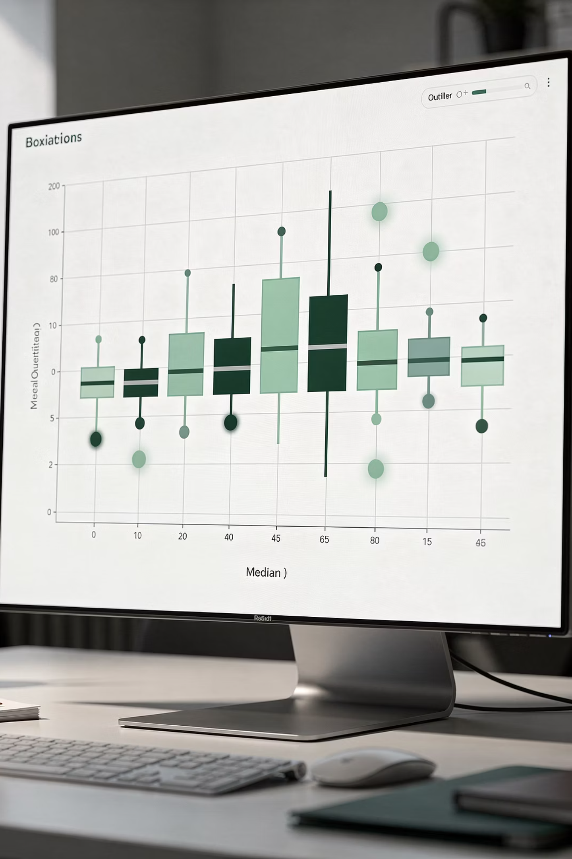
Understanding Outliers
Outliers are data points that significantly differ from other observations. They can represent genuine variations or measurement errors and require careful handling.
Univariate Outliers
Extreme values in a single variable that lie far from the central tendency
Multivariate Outliers
Unusual combinations of values across multiple variables
Genuine Variations
Valid extreme values that represent real phenomena
Measurement Errors
Incorrect values due to data collection or entry mistakes

Slide 12

Outlier Detection Methods
Statistical Methods
Visualization
ML Methods
Z-Score
Box Plot
Isolation Forest
Values beyond 3 standard deviations from mean
Visual representation of quartiles
Unsupervised algorithm
Scatter Plot
Local Outlier Factor
IQR Method
For bivariate outliers
Density-based method
Values beyond 1.5 × IQR from Q1/Q3
Histogram
Modified Z-Score
Distribution analysis
Robust to outliers using median

Slide 13
Outlier Treatment Strategies
Deletion
Capping
Transformation
Remove outlier observations completely from the dataset
Set outliers to upper or lower bounds to limit their impact
Apply log or square root transformations to reduce skewness
Imputation
Separate Modeling
Replace outliers with mean, median, or other statistical measures
Treat outliers as special cases requiring different models

Slide 14
Python Implementation: IQR Method
import pandas as pd
import numpy as np
# Sample data with outlier
data = [10, 12, 14, 15, 16, 18, 20, 100]
df = pd.DataFrame(data, columns=['Value'])
# Calculate Q1, Q3, IQR
Q1 = df['Value'].quantile(0.25)
Q3 = df['Value'].quantile(0.75)
IQR = Q3 - Q1
# Define bounds
lower_bound = Q1 - 1.5 * IQR
upper_bound = Q3 + 1.5 * IQR
# Identify and remove outliers
outliers = df[(df['Value'] < lower_bound) |
(df['Value'] > upper_bound)]
df_clean = df[(df['Value'] >= lower_bound) &
(df['Value'] <= upper_bound)]
The IQR method is robust and widely used for outlier detection in statistical analysis.

Slide 15
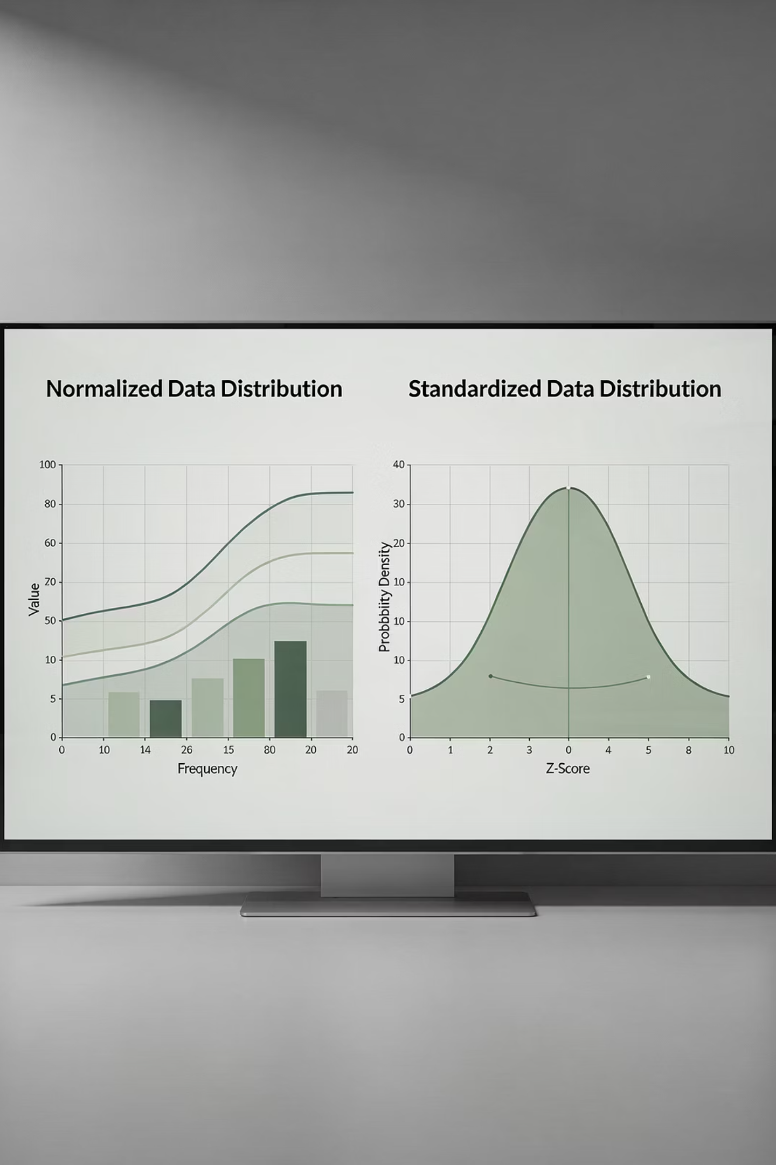


Normalization vs Standardization
These techniques bring all features to a similar scale, essential for many machine learning algorithms.
Normalization (Min-Max Scaling)
Standardization (Z-Score)
Scales data to a fixed range, usually [0,1]
Scales data to have mean 0 and standard deviation 1
When to Use:
When to Use:
Features have different units
KNN, Neural Networks
Data follows normal distribution
Data doesn't follow normal distribution
Linear Regression, Logistic Regression
Features have different scales

Slide 16
Scaling Methods Comparison
Technique
Use Case
Algorithm Examples
Normalization
Bounded data, image processing
KNN, Neural Networks
Standardization
Normally distributed data
Linear Regression, PCA
Robust Scaler
Data with outliers
All algorithms when outliers present
MaxAbs Scaler
Sparse data
Text data, sparse matrices
Power Transformer
Skewed distributions
Algorithms assuming normality

Slide 17
Python Implementation: Scaling
from sklearn.preprocessing import MinMaxScaler, StandardScaler
# Sample data
data = [[1, 2], [3, 4], [5, 6], [7, 8]]
# Min-Max Normalization
scaler = MinMaxScaler()
normalized_data = scaler.fit_transform(data)
print("Normalized Data:")
print(normalized_data)
# Standardization
scaler = StandardScaler()
standardized_data = scaler.fit_transform(data)
print("\nStandardized Data:")
print(standardized_data)
Both techniques are implemented using scikit-learn's preprocessing module, making them easy to apply in practice.

Slide 18

Encoding Categorical Variables
Machine learning algorithms work with numerical data. Categorical variables must be converted to numerical format through encoding techniques.
1
Nominal Data
Categories with no inherent order (e.g., colors: red, blue, green)
2
Ordinal Data
Categories with meaningful order (e.g., size: small, medium, large)

Slide 19
Label Encoding
Assigns integer values to categories, creating a numerical representation.
Example Mapping
from sklearn.preprocessing import LabelEncoder
# Sample data
colors = ['Red', 'Blue', 'Green',
'Red', 'Blue']
encoder = LabelEncoder()
encoded_colors = encoder.fit_transform(colors)
print("Original:", colors)
print("Encoded:", encoded_colors)
print("Classes:", encoder.classes_)
Red → 0
Blue → 1
Green → 2
Limitations
Implies order where none exists
May affect algorithms assuming numerical relationships
Not suitable for nominal data

Slide 20
One-Hot Encoding
Creates binary columns for each category, avoiding false ordinal relationships.
Red
Blue
Green
[1, 0, 0]
[0, 1, 0]
[0, 0, 1]
Advantages
No ordinal relationships assumed
Works well with most algorithms
Preserves categorical nature

Slide 21
Python Implementation: One-Hot Encoding
import pandas as pd
from sklearn.preprocessing import OneHotEncoder
# Sample data
data = {'Color': ['Red', 'Blue', 'Green', 'Red'],
'Size': ['Small', 'Medium', 'Large', 'Medium']}
df = pd.DataFrame(data)
# Using pandas get_dummies
encoded_df = pd.get_dummies(df, columns=['Color', 'Size'])
print("One-Hot Encoded Data:")
print(encoded_df)
# Using sklearn
encoder = OneHotEncoder()
encoded_array = encoder.fit_transform(df[['Color']]).toarray()
print("\nSklearn One-Hot Encoding:")
print(encoded_array)
Pandas get_dummies provides a quick solution, while sklearn offers more control and consistency.

Slide 22
Feature Scaling in Practice
Feature scaling ensures all features contribute equally to the model, preventing features with larger scales from dominating.
Algorithms Requiring Scaling
Algorithms Not Requiring Scaling
K-Nearest Neighbors (KNN)
Decision Trees
Support Vector Machines (SVM)
Random Forest
Neural Networks
Gradient Boosting Trees
Principal Component Analysis (PCA)
Naive Bayes
Gradient Descent-based algorithms

Slide 23

Data Splitting Strategies
Proper data splitting ensures reliable model evaluation and prevents overfitting.
70-80%
10-15%
20-30%
Training Set
Validation Set
Test Set
Used to train the model and learn patterns from data
Optional set for hyperparameter tuning and model selection
Used to evaluate final model performance on unseen data

Slide 24
Cross-Validation Techniques
K-Fold CV
Leave-One-Out
Data divided into k folds, model trained k times with different test fold each time
Each sample used as test set once, computationally expensive but thorough
1
2
3
4
Stratified K-Fold
Time Series Split
Maintains class distribution in each fold, important for imbalanced datasets
Respects temporal order, essential for time-dependent data

Slide 25
Python Implementation: Train-Test Split
from sklearn.model_selection import train_test_split
# Sample data
X = [[1, 2], [3, 4], [5, 6], [7, 8], [9, 10]]
y = [0, 0, 1, 1, 1]
X_train, X_test, y_train, y_test = train_test_split(
X, y, test_size=0.2, random_state=42)
print("Training features:", X_train)
print("Test features:", X_test)
print("Training labels:", y_train)
print("Test labels:", y_test)
The random_state parameter ensures reproducibility, while test_size controls the split ratio.

Slide 26
Common Preprocessing Mistakes
1
Data Leakage
Using test data information during training, leading to overly optimistic performance estimates
2
Scaling Before Splitting
Should always split data first, then scale to prevent information leakage from test set
3
Over-preprocessing
Applying unnecessary transformations that may remove important patterns
4
Ignoring Data Types
Treating categorical variables as numerical without proper encoding
5
Removing Outliers Blindly
May lose important information; always investigate before removal
6
Not Handling Class Imbalance
Ignoring imbalanced classes in classification problems affects model performance

Slide 27
Real-World Applications
Healthcare
Finance
Preprocessing patient data for disease prediction, handling missing medical records, and normalizing lab test results for accurate diagnosis models
Credit scoring with mixed data types, fraud detection with outlier handling, and stock price prediction with feature scaling
E-commerce
Image Processing
Customer segmentation with categorical encoding, recommendation systems with data normalization, and sales forecasting with time series preprocessing
Pixel normalization for computer vision, data augmentation for training, and feature extraction preprocessing

Slide 28

Exam Preparation Guide
Short Answer Topics
Long Answer Topics
Define data preprocessing and explain its importance
Complete data preprocessing pipeline with examples
Difference between normalization and standardization
Compare outlier detection and treatment methods
Methods to handle missing values
Importance of feature scaling in ML algorithms
One-hot encoding with examples
Techniques for encoding categorical variables
Cross-validation and its purpose
Practical Tip: Practice writing Python code for each preprocessing technique. Hands-on implementation solidifies understanding and prepares you for practical exams.

Slide 29
Terminal Learning Objectives
TLO 1: Understand Concepts
Grasp fundamental data preprocessing concepts and their role in machine learning
TLO 2: Handle Data Issues
Master techniques for handling missing values and outliers effectively
TLO 3: Apply Scaling
Implement normalization and standardization for feature scaling
TLO 4: Encode Variables
Convert categorical variables to numerical format using appropriate encoding
TLO 5: Split Data
Perform proper data splitting and validation for reliable model evaluation

Slide 30
Key Takeaways
Data preprocessing is the foundation of successful machine learning projects. Master these essential principles:
Always Preprocess
Handle Missing Values
Treat Outliers Carefully
Never feed raw data directly to ML algorithms
Choose appropriate methods based on data type and pattern
Investigate before removal to avoid losing information
Scale Features
Encode Properly
Split Correctly
Essential for distance-based algorithms
Use appropriate encoding for categorical variables
Prevent data leakage through proper splitting
Use Cross-Validation
Ensure reliable model evaluation
Mastering these techniques will significantly improve your machine learning model performance and prepare you for real-world applications.

