Slide 1

Feature Selection and Extraction
A comprehensive guide to dimensionality reduction techniques in machine learning for MSBTE diploma students.

Slide 2
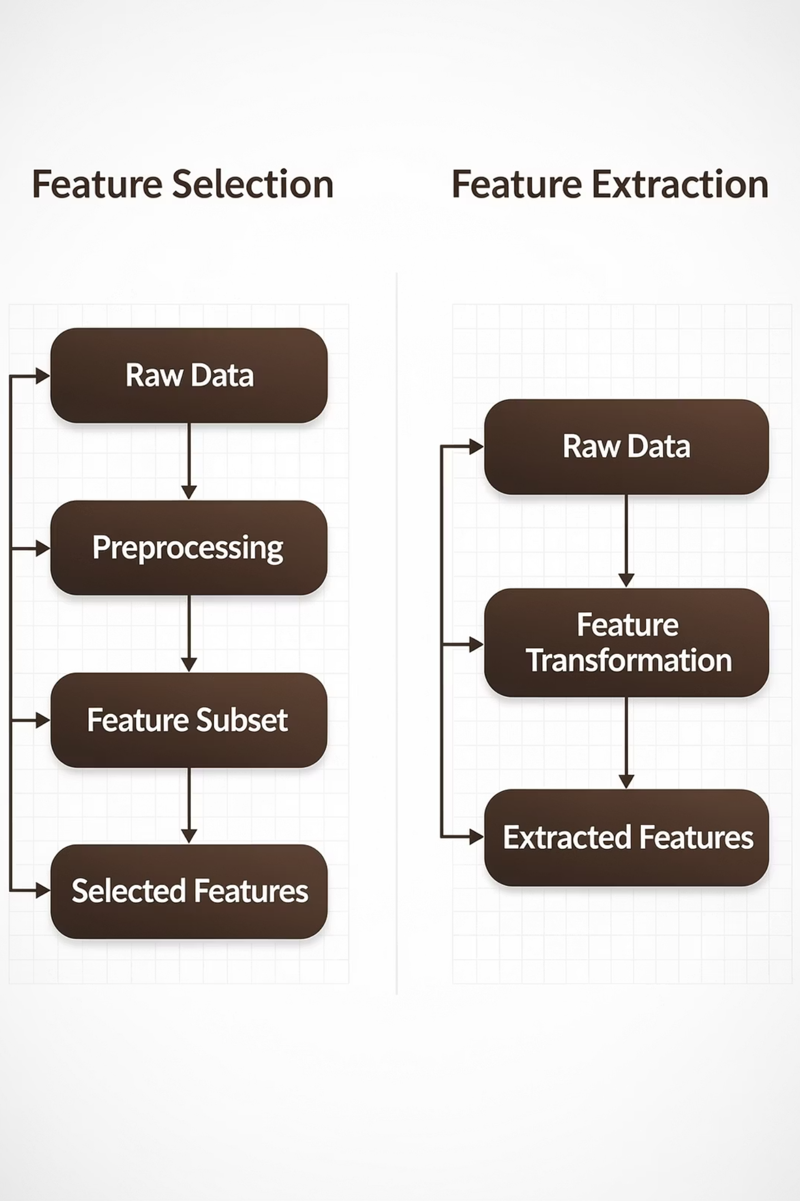
What Are Features?
Feature Selection
Feature Extraction
Selecting a subset of relevant features from the original dataset without transformation. Like choosing the best ingredients from your pantry.
Creating new features by combining or transforming existing ones. Like mixing ingredients to create a new recipe.
Transforms original features
Removes irrelevant features
Creates new representations
Keeps original feature meaning
Reduces dimensionality
Improves interpretability

Slide 3

The Curse of Dimensionality
As the number of features increases, data becomes increasingly sparse in the feature space. This phenomenon makes machine learning algorithms less effective and more computationally expensive.
Sparse Data
Overfitting Risk
Computational Cost
High dimensions spread data points far apart, making patterns harder to detect
Models memorize training data instead of learning generalizable patterns
More features require exponentially more processing time and memory

Slide 4

Why Feature Selection Matters
Improves Performance
Reduces Overfitting
Removes noisy and irrelevant features that confuse the model, leading to better predictions and higher accuracy.
Simpler models with fewer features generalize better to unseen data, preventing memorization of training patterns.
Faster Training
Better Interpretability
Fewer features mean less computation time and memory usage during model training and prediction.
Models with fewer features are easier to understand and explain to stakeholders and end users.
Handles Multicollinearity
Cost Reduction
Removes highly correlated features that provide redundant information and can destabilize models.
Fewer features mean lower data collection, storage, and processing costs in production systems.

Slide 5

Real-World Example: Customer Churn
Irrelevant Features
In a customer churn prediction model, selecting only behavioral features dramatically improves accuracy while reducing complexity. Features like customer ID provide no predictive value, while usage patterns and complaint history are strong indicators of churn risk.
Customer ID numbers
Registration timestamps
Internal system notes
Database record IDs
By removing irrelevant features, the model trains faster, generalizes better, and becomes easier to interpret for business stakeholders.
Relevant Features
Usage frequency patterns
Customer complaints
Payment history
Service interactions

Slide 6



Three Categories of Feature Selection
Filter Methods
Wrapper Methods
Embedded Methods
Select features based on statistical properties, independent of the learning algorithm. Fast and simple.
Use the learning algorithm as a black box to evaluate feature subsets. More accurate but slower.
Perform feature selection during model training. Balance between speed and accuracy.

Slide 7

Filter Methods
Filter methods evaluate features independently using statistical measures before training any model. They're fast and scalable but may miss feature interactions.
Correlation-Based Selection
1
Measures linear relationships between features and target using Pearson's, Spearman's, or Kendall's correlation coefficients.
Univariate Selection
2
Uses statistical tests like Chi-Square for categorical features, ANOVA F-test for numerical features, or mutual information.
Variance Threshold
3
Removes features with low variance that are constant or near-constant across samples, providing little information.

Slide 8
Filter Methods: Pros and Cons
Method
Advantages
Disadvantages
Correlation
Fast, simple to implement
Ignores feature interactions
Chi-Square
Good for categorical data
Only for classification tasks
Mutual Information
Captures non-linear relationships
Computationally expensive
Variance Threshold
Removes constant features
May remove useful low-variance features

Slide 9
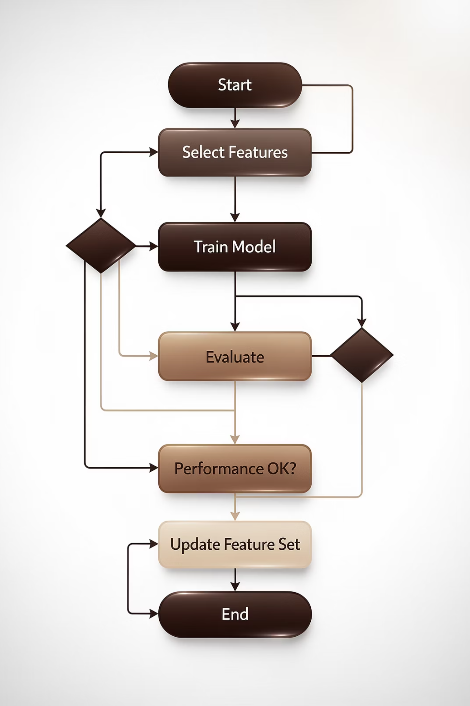
Wrapper Methods
Wrapper methods evaluate feature subsets by training and testing the actual learning algorithm. They consider feature interactions but are computationally intensive.
01
Forward Selection
Start with no features, iteratively add the feature that improves performance most
02
Backward Elimination
Start with all features, iteratively remove the feature whose absence improves performance
03
Recursive Feature Elimination
Use algorithm to rank features, recursively remove least important ones
04
Exhaustive Search
Try all possible feature combinations to find optimal subset

Slide 10
Wrapper Methods: Trade-offs
Forward Selection
RFE
Exhaustive Search
Pros: Simple, interpretable
Cons: May miss feature combinations
Pros: Considers feature importance
Cons: Computationally intensive
Pros: Finds optimal selection
Cons: Infeasible for large datasets

Slide 11
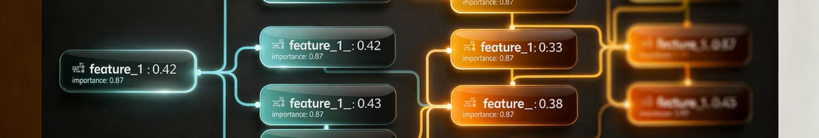
Embedded Methods
Embedded methods perform feature selection as part of the model training process, offering a balance between filter and wrapper approaches.
Regularization Methods
Tree-Based Methods
L1 (Lasso): Shrinks coefficients to exactly zero, performing automatic feature selection
Decision Trees: Calculate feature importance from split quality
Random Forest: Average importance across multiple trees
L2 (Ridge): Shrinks coefficients but doesn't eliminate features completely
Gradient Boosting: Importance from boosting iterations
Elastic Net: Combines L1 and L2 for balanced regularization

Slide 12

Principal Component Analysis (PCA)
PCA is an unsupervised dimensionality reduction technique that transforms data into principal components—new uncorrelated features ordered by variance explained.
Standardize Data
Scale features to mean=0, variance=1
Compute Covariance Matrix
Measure relationships between features
Calculate Eigenvectors
Find principal directions of variance
Sort by Eigenvalues
Order components by variance explained
Select Top Components
Choose k components retaining most variance
Transform Data
Project onto new coordinate system

Slide 13



PCA: Mathematical Foundation
PCA relies on linear algebra concepts to find the directions of maximum variance in high-dimensional data.
Covariance Matrix
Eigenvalue Equation
Eigenvectors (v) are principal directions, eigenvalues (λ) are variance
Captures relationships between all feature pairs
Explained Variance
Proportion of total variance captured by each component

Slide 14
When to Use PCA
High-Dimensional Data
Correlated Features
Datasets with hundreds or thousands of features that need compression
When features are highly correlated and provide redundant information
Visualization Needs
Noise Reduction
Reduce to 2D or 3D for plotting and exploratory data analysis
Remove components with low variance that likely represent noise

Slide 15
Linear Discriminant Analysis (LDA)
LDA is a supervised dimensionality reduction technique that maximizes class separability by finding linear combinations of features that best separate different classes.
Compute Class Means
1
Calculate average feature values for each class
2
Within-Class Scatter
Measure variance within each class
Between-Class Scatter
3
Measure variance between class means
4
Find Discriminants
Maximize between/within scatter ratio
Project Data
5
Transform onto discriminant directions

Slide 16
PCA vs LDA: Key Differences
Aspect
PCA
LDA
Supervision
Unsupervised - no labels needed
Supervised - requires class labels
Goal
Maximize total variance
Maximize class separation
Components
Principal directions of variance
Discriminant directions
Use Case
General dimensionality reduction
Classification problems only
Max Components
Up to number of features
Up to number of classes - 1

Slide 17
Other Feature Extraction Techniques
Independent Component Analysis
t-SNE
Autoencoders
Separates multivariate signals into additive independent subcomponents, useful for blind source separation.
Non-linear dimensionality reduction excellent for visualizing high-dimensional data in 2D or 3D space.
Neural network-based feature extraction that learns compressed representations through encoding-decoding.

Slide 18
Python Implementation: Correlation Filter
import pandas as pd
import seaborn as sns
import matplotlib.pyplot as plt
# Sample data
data = {'Feature1': [1, 2, 3, 4, 5],
'Feature2': [2, 4, 6, 8, 10],
'Feature3': [1, 3, 5, 7, 9],
'Target': [0, 0, 1, 1, 1]}
df = pd.DataFrame(data)
# Calculate correlation matrix
correlation_matrix = df.corr()
# Plot heatmap
sns.heatmap(correlation_matrix, annot=True, cmap='coolwarm')
plt.title('Feature Correlation Heatmap')
plt.show()
# Select features with correlation > 0.5 with target
target_corr = correlation_matrix['Target'].abs()
selected_features = target_corr[target_corr > 0.5].index.tolist()
selected_features.remove('Target')
print("Selected Features:", selected_features)

Slide 19
Python Implementation: RFE
from sklearn.feature_selection import RFE
from sklearn.linear_model import LogisticRegression
from sklearn.datasets import make_classification
# Generate sample data
X, y = make_classification(n_samples=100,
n_features=10,
n_informative=5,
random_state=42)
# Create and fit RFE
model = LogisticRegression()
rfe = RFE(model, n_features_to_select=5)
rfe.fit(X, y)
# Print results
print("Selected Features:", rfe.support_)
print("Feature Ranking:", rfe.ranking_)
print("Selected Indices:",
[i for i, x in enumerate(rfe.support_) if x])
RFE recursively removes the least important features based on model coefficients or feature importances.

Slide 20
Python Implementation: Random Forest Importance
from sklearn.ensemble import RandomForestClassifier
from sklearn.datasets import make_classification
import matplotlib.pyplot as plt
import numpy as np
# Generate sample data
X, y = make_classification(n_samples=1000,
n_features=20,
n_informative=10,
random_state=42)
# Train Random Forest
rf = RandomForestClassifier(n_estimators=100, random_state=42)
rf.fit(X, y)
# Get feature importances
importances = rf.feature_importances_
# Plot feature importances
plt.bar(range(len(importances)), importances)
plt.xlabel('Feature Index')
plt.ylabel('Importance')
plt.title('Random Forest Feature Importances')
plt.show()
# Select top 10 features
indices = np.argsort(importances)[::-1][:10]
print("Top 10 Features:", indices)

Slide 21
Python Implementation: PCA
from sklearn.decomposition import PCA
from sklearn.datasets import load_iris
import matplotlib.pyplot as plt
# Load iris dataset
iris = load_iris()
X = iris.data
y = iris.target
# Apply PCA
pca = PCA(n_components=2)
X_pca = pca.fit_transform(X)
print("Original shape:", X.shape)
print("PCA shape:", X_pca.shape)
print("Explained variance ratio:",
pca.explained_variance_ratio_)
print("Total explained variance:",
sum(pca.explained_variance_ratio_))
# Plot PCA results
colors = ['red', 'green', 'blue']
for i, color in enumerate(colors):
plt.scatter(X_pca[y == i, 0],
X_pca[y == i, 1],
color=color,
label=iris.target_names[i])
plt.xlabel('PC1')
plt.ylabel('PC2')
plt.legend()
plt.show()

Slide 22
Python Implementation: LDA
from sklearn.discriminant_analysis import LinearDiscriminantAnalysis
from sklearn.datasets import load_iris
import matplotlib.pyplot as plt
# Load data
iris = load_iris()
X = iris.data
y = iris.target
# Apply LDA
lda = LinearDiscriminantAnalysis(n_components=2)
X_lda = lda.fit_transform(X, y)
print("LDA shape:", X_lda.shape)
print("Explained variance ratio:",
lda.explained_variance_ratio_)
# Plot LDA results
colors = ['red', 'green', 'blue']
for i, color in enumerate(colors):
plt.scatter(X_lda[y == i, 0],
X_lda[y == i, 1],
color=color,
label=iris.target_names[i])
plt.xlabel('LD1')
plt.ylabel('LD2')
plt.title('LDA of Iris Dataset')
plt.legend()
plt.show()
LDA creates linear combinations that maximize separation between classes.

Slide 23

Evaluating Feature Selection
Proper evaluation ensures selected features improve model performance and generalize well to unseen data.
1
Model Performance Metrics
Evaluate using accuracy, precision, recall, F1-score, and ROC-AUC on validation data
2
Computational Efficiency
Measure training time, prediction time, and memory usage with selected features
3
Stability Analysis
Check consistency of selected features across different data subsets and random seeds
4
Interpretability Assessment
Evaluate how easy it is to understand and explain the selected features to stakeholders

Slide 24
Cross-Validation for Feature Selection
from sklearn.model_selection import cross_val_score
from sklearn.tree import DecisionTreeClassifier
# Evaluate feature selection
def evaluate_features(X_selected, y):
model = DecisionTreeClassifier(random_state=42)
scores = cross_val_score(model, X_selected, y, cv=5)
return scores.mean(), scores.std()
# Compare original vs selected features
original_score = evaluate_features(X, y)
selected_score = evaluate_features(X[:, indices], y)
print(f"Original CV Score: {original_score[0]:.3f} "
f"(±{original_score[1]:.3f})")
print(f"Selected CV Score: {selected_score[0]:.3f} "
f"(±{selected_score[1]:.3f})")
Always use cross-validation during feature selection to avoid overfitting and ensure robust performance estimates.

Slide 25
Common Challenges and Solutions
Computational Complexity
Challenge: Wrapper methods are slow for large datasets
Solution: Use filter methods first or sample data for wrapper methods
Feature Interactions
Challenge: Filter methods ignore feature combinations
Solution: Use wrapper or embedded methods that consider interactions
Overfitting in Selection
Challenge: Features work well only on training data
Solution: Use nested cross-validation during feature selection
Interpretability vs Performance
Challenge: Complex methods sacrifice explainability
Solution: Balance between performance gains and interpretability needs

Slide 26





Real-World Applications
Image Processing
Text Mining
PCA for face recognition, feature extraction for object detection, image compression
Feature selection for document classification, PCA for topic modeling, sentiment analysis
Bioinformatics
Gene selection for disease prediction, microarray data analysis, protein classification
Recommendation Systems
Feature extraction from user-item interactions, collaborative filtering, content-based filtering
Finance
Credit scoring, risk factor analysis, portfolio optimization, fraud detection

Slide 27
Comparison of Dimensionality Reduction Methods
Method
Type
Supervision
Best For
Limitations
PCA
Linear
Unsupervised
General DR, visualization
Assumes linearity
LDA
Linear
Supervised
Classification tasks
Requires labeled data
ICA
Linear
Unsupervised
Signal separation
Assumes independence
t-SNE
Non-linear
Unsupervised
Visualization only
Not for general DR
Autoencoder
Non-linear
Unsupervised
Complex patterns
Requires neural networks

Slide 28
Exam Practice Questions
Short Answer Questions
Long Answer Questions
Practical Questions
What is the difference between feature selection and feature extraction?
Explain the working principle of Principal Component Analysis with mathematical foundation
Implement correlation-based feature selection in Python
Apply PCA on the iris dataset and visualize the results
Explain the three main categories of feature selection methods
Discuss different feature selection methods with their advantages and disadvantages
Use RFE for feature selection with SVM classifier
What is PCA and how does it work?
Compare PCA and LDA with examples
Compare supervised and unsupervised dimensionality reduction techniques
Compare feature importance from Random Forest and Gradient Boosting
Why is dimensionality reduction important in machine learning?
Explain how wrapper methods work for feature selection with a practical example

Slide 29
Key Takeaways
Feature Selection
1
Choose relevant features using filter, wrapper, or embedded methods based on your dataset size and computational resources
Feature Extraction
2
Create new features using PCA for unsupervised tasks or LDA for classification problems
Dimensionality Reduction
3
Reduce complexity while preserving important information to improve model performance
Evaluation
4
Always validate feature selection using cross-validation to ensure generalization
Trade-offs
5
Balance between performance, interpretability, and computational cost based on your specific requirements

Slide 30

Master Feature Engineering
Mastering feature selection and extraction techniques will help you build better machine learning models, understand underlying data patterns, and create more efficient solutions for real-world problems.
"Feature engineering is the art of extracting useful patterns from raw data. Master these techniques, and you'll unlock the true potential of machine learning."
Unit III Complete - MSBTE K-Scheme Machine Learning Course

