Slide 1

Supervised Learning Algorithms
A comprehensive guide to supervised learning algorithms for MSBTE K-Scheme diploma students. This presentation covers decision trees, KNN, SVM, linear regression, logistic regression, and model evaluation techniques with practical Python implementations.

Slide 2

What is Supervised Learning?
Core Concept
Supervised learning is a type of machine learning where algorithms learn from labeled training data to make predictions on new, unseen data. The algorithm learns patterns by studying examples with known outputs.
Labeled Data: Training data with known outputs
Features: Independent variables (X)
Target: Dependent variable (Y)
Training Phase: Learning patterns
Prediction Phase: Applying learned patterns

Slide 3
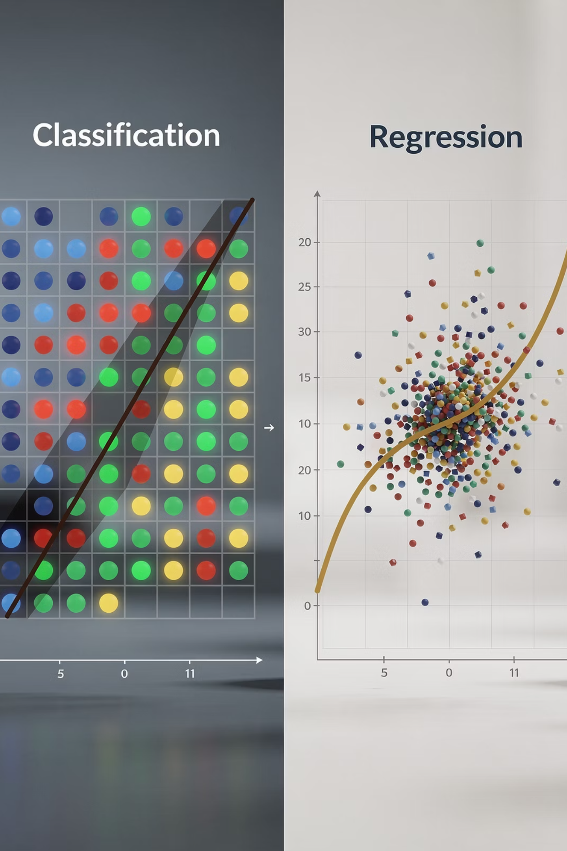
Types of Supervised Learning
Regression
Predicts continuous numerical values
House price prediction
Stock price forecasting
Temperature prediction
Sales forecasting
Classification
Predicts discrete categories or classes
Email spam detection
Disease diagnosis
Customer churn prediction
Image recognition

Slide 4







Supervised Learning Workflow
Data Collection
Gather relevant labeled datasets for training
Data Preprocessing
Clean, normalize, and prepare data for analysis
Feature Selection
Identify most important variables for prediction
Algorithm Selection
Choose appropriate model for the problem
Model Training
Train algorithm on prepared dataset
Model Evaluation
Test performance using validation metrics
Model Deployment
Deploy model for real-world predictions

Slide 5

Decision Tree Algorithm
Decision trees are versatile algorithms that perform both classification and regression by recursively splitting data based on feature values. They create a flowchart-like structure where internal nodes represent features, branches represent decision rules, and leaf nodes represent outcomes.
The algorithm works by finding the best feature to split on at each node, partitioning data based on feature values, and repeating until stopping criteria are met. This creates an intuitive, interpretable model that mimics human decision-making.

Slide 6
How Decision Trees Work
01
02
03
Start at Root
Select Best Feature
Partition Data
Begin with all training data at the root node
Choose feature that best separates the classes
Split data based on selected feature values
04
05
Repeat Recursively
Stop When Criteria Met
Apply same process to each subset
End when all instances belong to same class or maximum depth reached

Slide 7

Splitting Criteria for Decision Trees
Classification Metrics
Regression Metrics
Gini Impurity
Mean Squared Error
Measures node purity. Formula: Gini = 1 - Σ(p_i²) where p_i is proportion of class i. Lower values indicate purer nodes.
Measures average squared difference between predicted and actual values. Commonly used for regression trees.
Entropy
Mean Absolute Error
Measures disorder. Formula: Entropy = -Σ(p_i * log₂(p_i)). Used to calculate information gain.
Measures average absolute difference. More robust to outliers than MSE.
Information Gain
Reduction in entropy after split. IG = Entropy(parent) - Σ(weighted_entropy(children))

Slide 8
Pruning Techniques
Pre-pruning (Early Stopping)
Post-pruning
Stop growing tree before it becomes too complex by setting constraints during construction.
Grow full tree first, then remove branches that don't improve performance.
Maximum tree depth
Reduced Error Pruning: Remove branches if accuracy improves
Minimum samples per split
Minimum samples per leaf
Cost Complexity Pruning: Balance accuracy vs complexity
Maximum number of leaf nodes
Prevents overfitting on training data

Slide 9

K-Nearest Neighbors (KNN)
KNN is a simple, instance-based learning algorithm that classifies new instances based on similarity to training instances. It's a "lazy learner" that stores all training data and makes decisions at prediction time by finding the K closest neighbors.
The algorithm calculates distances between the new point and all training points, selects K nearest neighbors, and uses majority voting (classification) or averaging (regression) to make predictions. No explicit training phase is required.

Slide 10

How KNN Works
Calculate Distance
Store Training Data
Compute distance between new instance and all training instances using chosen metric
Memorize all training examples with their labels
Make Prediction
Find K Neighbors
Classification: majority vote among neighbors. Regression: average of neighbor values
Select K closest training instances based on calculated distances

Slide 11
Distance Metrics in KNN
Euclidean Distance (L2)
Manhattan Distance (L1)
Most common metric. Calculates straight-line distance: d = √(Σ(x_i - y_i)²)
Sum of absolute differences: d = Σ|x_i - y_i|. Useful for grid-like paths.
Minkowski Distance (Lp)
Hamming Distance
Generalization of Euclidean and Manhattan: d = (Σ|x_i - y_i|^p)^(1/p)
For categorical variables. Counts positions where values differ.

Slide 12
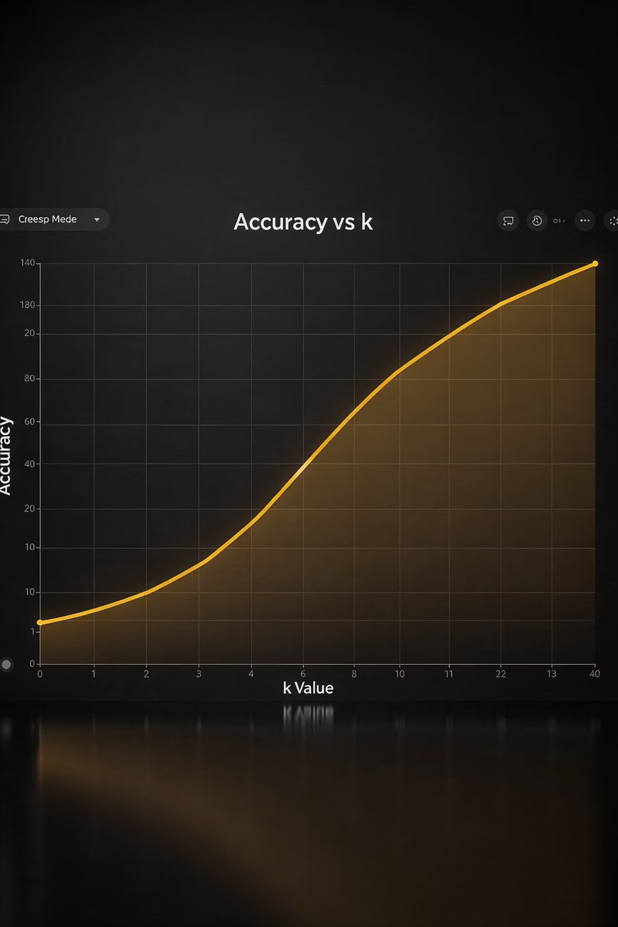
Choosing the Right K Value
Small K (e.g., K=1)
Large K (e.g., K=20)
Finding Optimal K
Advantages:
Use odd K to avoid ties in binary classification
Advantages:
Captures local patterns
More stable predictions
Apply cross-validation to test different K values
Low bias
Flexible boundaries
Less sensitive to noise
Disadvantages:
Rule of thumb: K = √(n) where n is sample size
Smoother boundaries
High variance
Sensitive to noise
Disadvantages:
Plot accuracy vs K to visualize performance
Overfitting risk
May miss local patterns
Higher bias
Underfitting risk

Slide 13

Support Vector Machine (SVM)
SVM is a powerful supervised learning algorithm that finds the optimal hyperplane to separate classes in feature space. It maximizes the margin between classes, making it robust and effective for complex classification tasks.
Support vectors are the data points closest to the hyperplane that define the margin. The algorithm focuses on these critical points rather than all training data, making it memory-efficient and effective even in high-dimensional spaces.

Slide 14
Linear vs Non-Linear SVM
Linear SVM
Non-Linear SVM
Used when data is linearly separable. Finds a straight hyperplane that maximizes margin between classes.
Uses kernel trick to transform data into higher-dimensional space where linear separation is possible.
Mathematical Formulation:
Kernel Functions:
Minimize: (1/2)||w||² subject to: y_i(w·x_i + b) ≥ 1
Polynomial: K(x,y) = (x·y + c)^d
Best for: Linearly separable data, text classification, simple boundaries
RBF: K(x,y) = exp(-γ||x-y||²)
Sigmoid: K(x,y) = tanh(α(x·y) + c)
Best for: Complex non-linear boundaries, image recognition

Slide 15
SVM Kernel Functions
Linear Kernel
Polynomial Kernel
RBF (Radial Basis Function)
Sigmoid Kernel
No transformation. Best for linearly separable data. Fast and interpretable. No additional parameters needed.
Creates polynomial decision boundaries. Parameters: degree and coef0. Good for non-linear but smooth boundaries.
Neural network-like behavior. Parameters: coef0. Similar to neural network activation functions.
Most popular for complex boundaries. Parameter: gamma controls influence. Smaller gamma = smoother, larger = more complex.

Slide 16
SVM Hyperparameters
C Parameter
Gamma Parameter
Regularization parameter that controls trade-off between margin maximization and misclassification.
Kernel coefficient for RBF, polynomial, and sigmoid kernels. Defines influence of single training example.
Small C: Wider margin, more misclassification tolerance, simpler model
Small gamma: Far reach, smoother decision boundary
Large gamma: Close reach, more complex boundary
Large C: Narrower margin, less misclassification tolerance, complex model
Options: 'scale' (default) or 'auto'
Default: C = 1.0

Slide 17
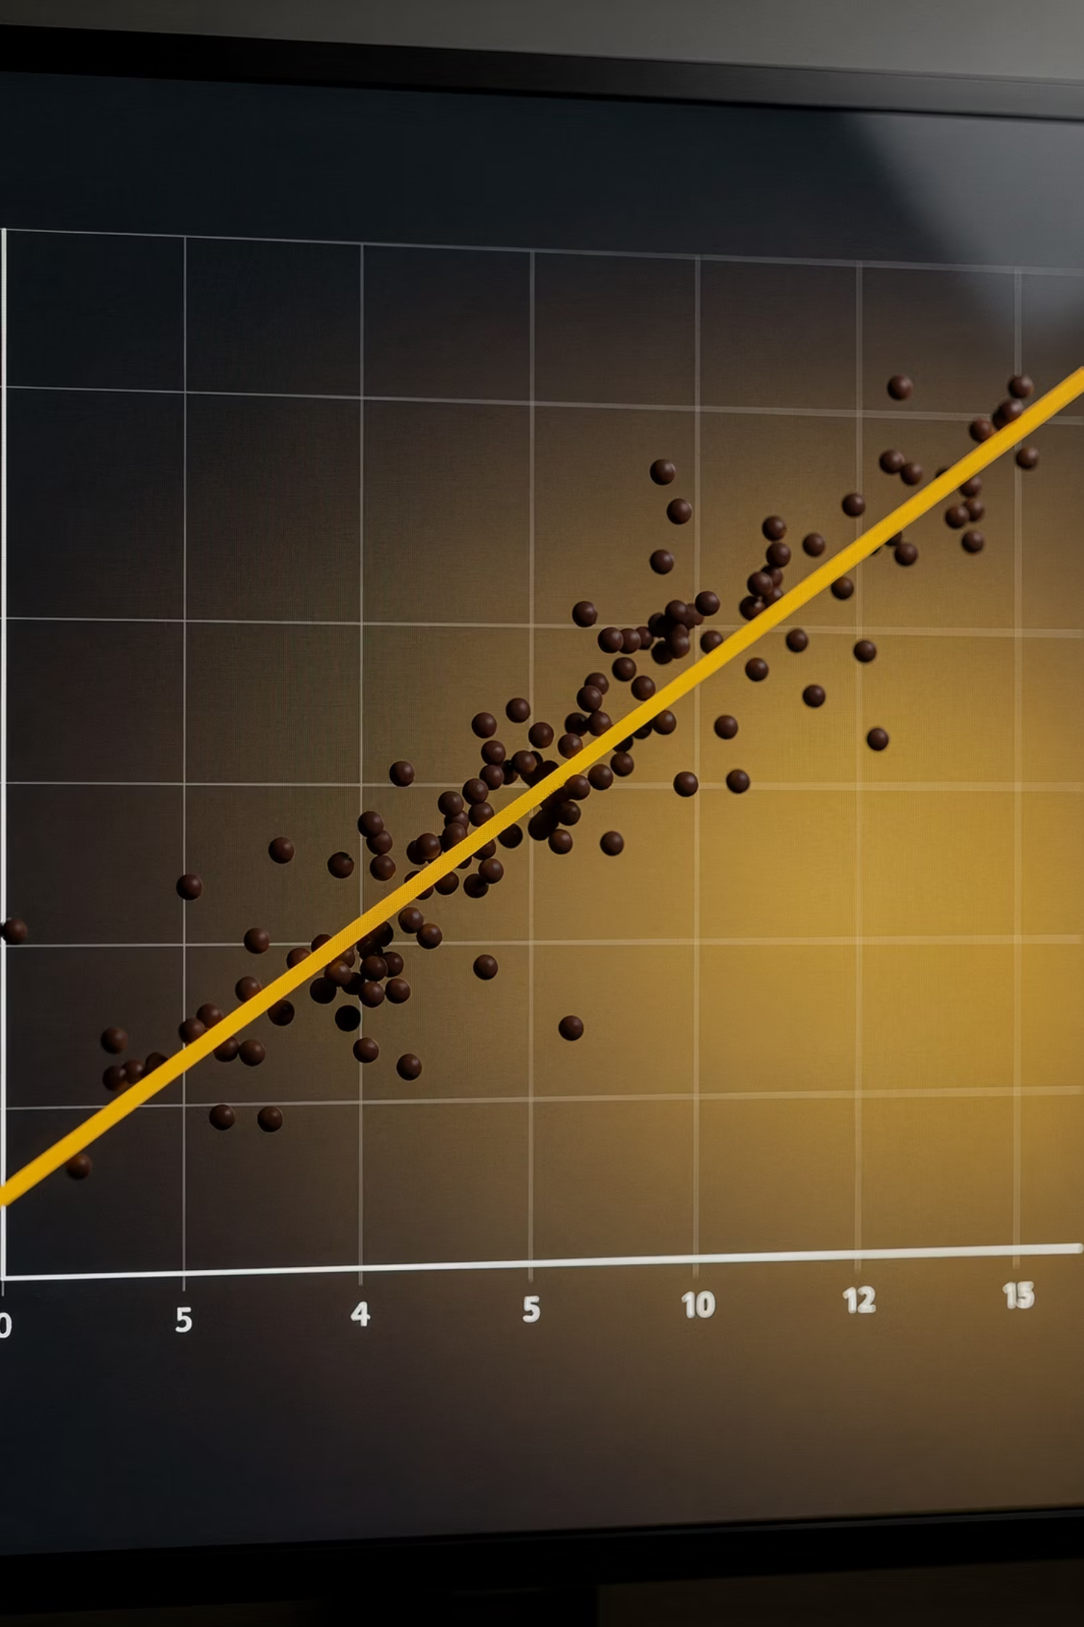
Linear Regression
Linear regression models the relationship between dependent and independent variables by fitting a linear equation to observed data. It's the foundation of predictive modeling for continuous outcomes.
The algorithm finds the best-fitting straight line through data points by minimizing the sum of squared differences between predicted and actual values. Simple linear regression uses one independent variable, while multiple linear regression uses several.

Slide 18

Linear Regression Fundamentals
Simple Linear Regression
Key Assumptions
Model: y = mx + c
Linearity: Linear relationship between variables
y: dependent variable (target)
Independence: Observations are independent
x: independent variable (feature)
Homoscedasticity: Constant variance of residuals
m: slope/coefficient
Normality: Residuals are normally distributed
c: intercept
Multiple Linear Regression
Model: y = b₀ + b₁x₁ + b₂x₂ + ... + bₙxₙ + ε
Matrix form: y = Xβ + ε

Slide 19
Cost Function and Optimization
01
02
Define Cost Function
Initialize Parameters
Mean Squared Error (MSE) = (1/n) Σ(y_i - ŷ_i)². Measures average squared difference between predictions and actual values.
Start with random or zero values for coefficients (θ). These will be optimized during training.
03
04
Compute Predictions
Calculate Gradient
Calculate predicted values (ŷ) using current parameters: ŷ = Xθ
Compute partial derivatives of cost function with respect to each parameter: ∂J/∂θ
05
06
Update Parameters
Repeat Until Convergence
Adjust parameters in direction of steepest descent: θ = θ - α * ∂J/∂θ where α is learning rate
Continue iterations until cost function stops decreasing significantly or maximum iterations reached

Slide 20

Logistic Regression
Logistic regression is a classification algorithm that predicts the probability of a binary outcome using the sigmoid function. Despite its name, it's used for classification, not regression.
The algorithm transforms linear combinations of features through the sigmoid function to produce probabilities between 0 and 1. A threshold (typically 0.5) converts probabilities to class predictions, making it ideal for binary classification tasks like spam detection or disease diagnosis.

Slide 21
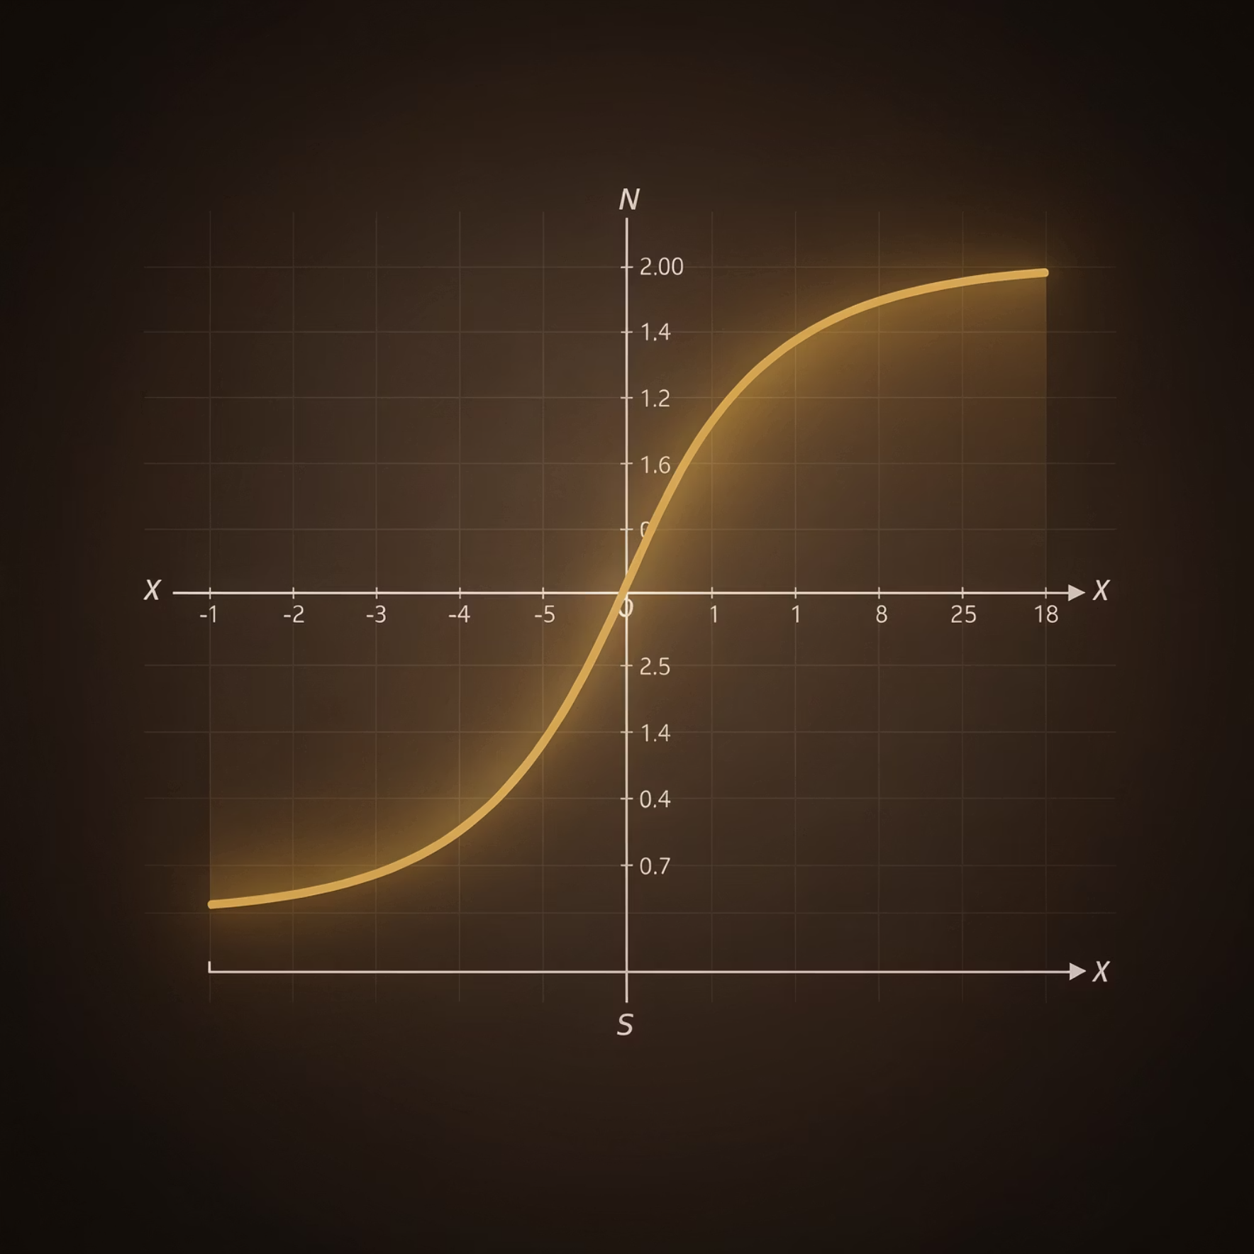
Sigmoid Function and Cost Function
Sigmoid Function
Log Loss (Binary Cross-Entropy)
Formula: σ(z) = 1 / (1 + e^(-z))
Formula: J = -(1/n) Σ[y_i log(ŷ_i) + (1-y_i) log(1-ŷ_i)]
Where z = w·x + b
Why Not MSE?
Properties
MSE creates non-convex optimization landscape
Output range: (0, 1)
Multiple local minima make optimization difficult
S-shaped curve
Log loss is convex for logistic regression
Differentiable everywhere
Better suited for probabilistic interpretation
Maps any real value to probability

Slide 22
Multi-class Classification
1
2
One-vs-Rest (OvR)
Softmax Regression
Train n binary classifiers for n classes. Each classifier predicts probability of belonging to one class vs all others. Choose class with highest probability.
Generalization of logistic regression for multiple classes. Uses softmax function instead of sigmoid to produce probability distribution over all classes.
Example: For 3 classes (A, B, C), train classifiers: A vs (B,C), B vs (A,C), C vs (A,B)
Formula: P(y=k|x) = exp(z_k) / Σexp(z_j) where z = Wx + b

Slide 23

Model Evaluation Metrics
Evaluating model performance requires appropriate metrics based on the problem type. Classification and regression tasks use different evaluation approaches to measure accuracy, precision, and overall effectiveness.

Slide 24
Classification Metrics
Accuracy
Precision
Proportion of correct predictions: (TP + TN) / (TP + TN + FP + FN)
Proportion of positive predictions that are correct: TP / (TP + FP)
Best for balanced datasets
Important when false positives are costly
Recall (Sensitivity)
F1-Score
Proportion of actual positives correctly identified: TP / (TP + FN)
Harmonic mean of precision and recall: 2 * (Precision * Recall) / (Precision + Recall)
Important when false negatives are costly
Balances precision and recall

Slide 25
Regression Metrics
Mean Absolute Error (MAE)
Mean Squared Error (MSE)
Average absolute difference between predictions and actual values: MAE = (1/n) Σ|y_i - ŷ_i|
Average squared difference: MSE = (1/n) Σ(y_i - ŷ_i)²
Penalizes large errors more heavily. Commonly used for optimization.
Easy to interpret, same units as target variable. Robust to outliers.
Root Mean Squared Error (RMSE)
R² Score
Square root of MSE: RMSE = √MSE
Coefficient of determination: R² = 1 - (SS_res / SS_tot)
Same units as target variable. More interpretable than MSE.
Proportion of variance explained. Range: 0 to 1 (higher is better).

Slide 26
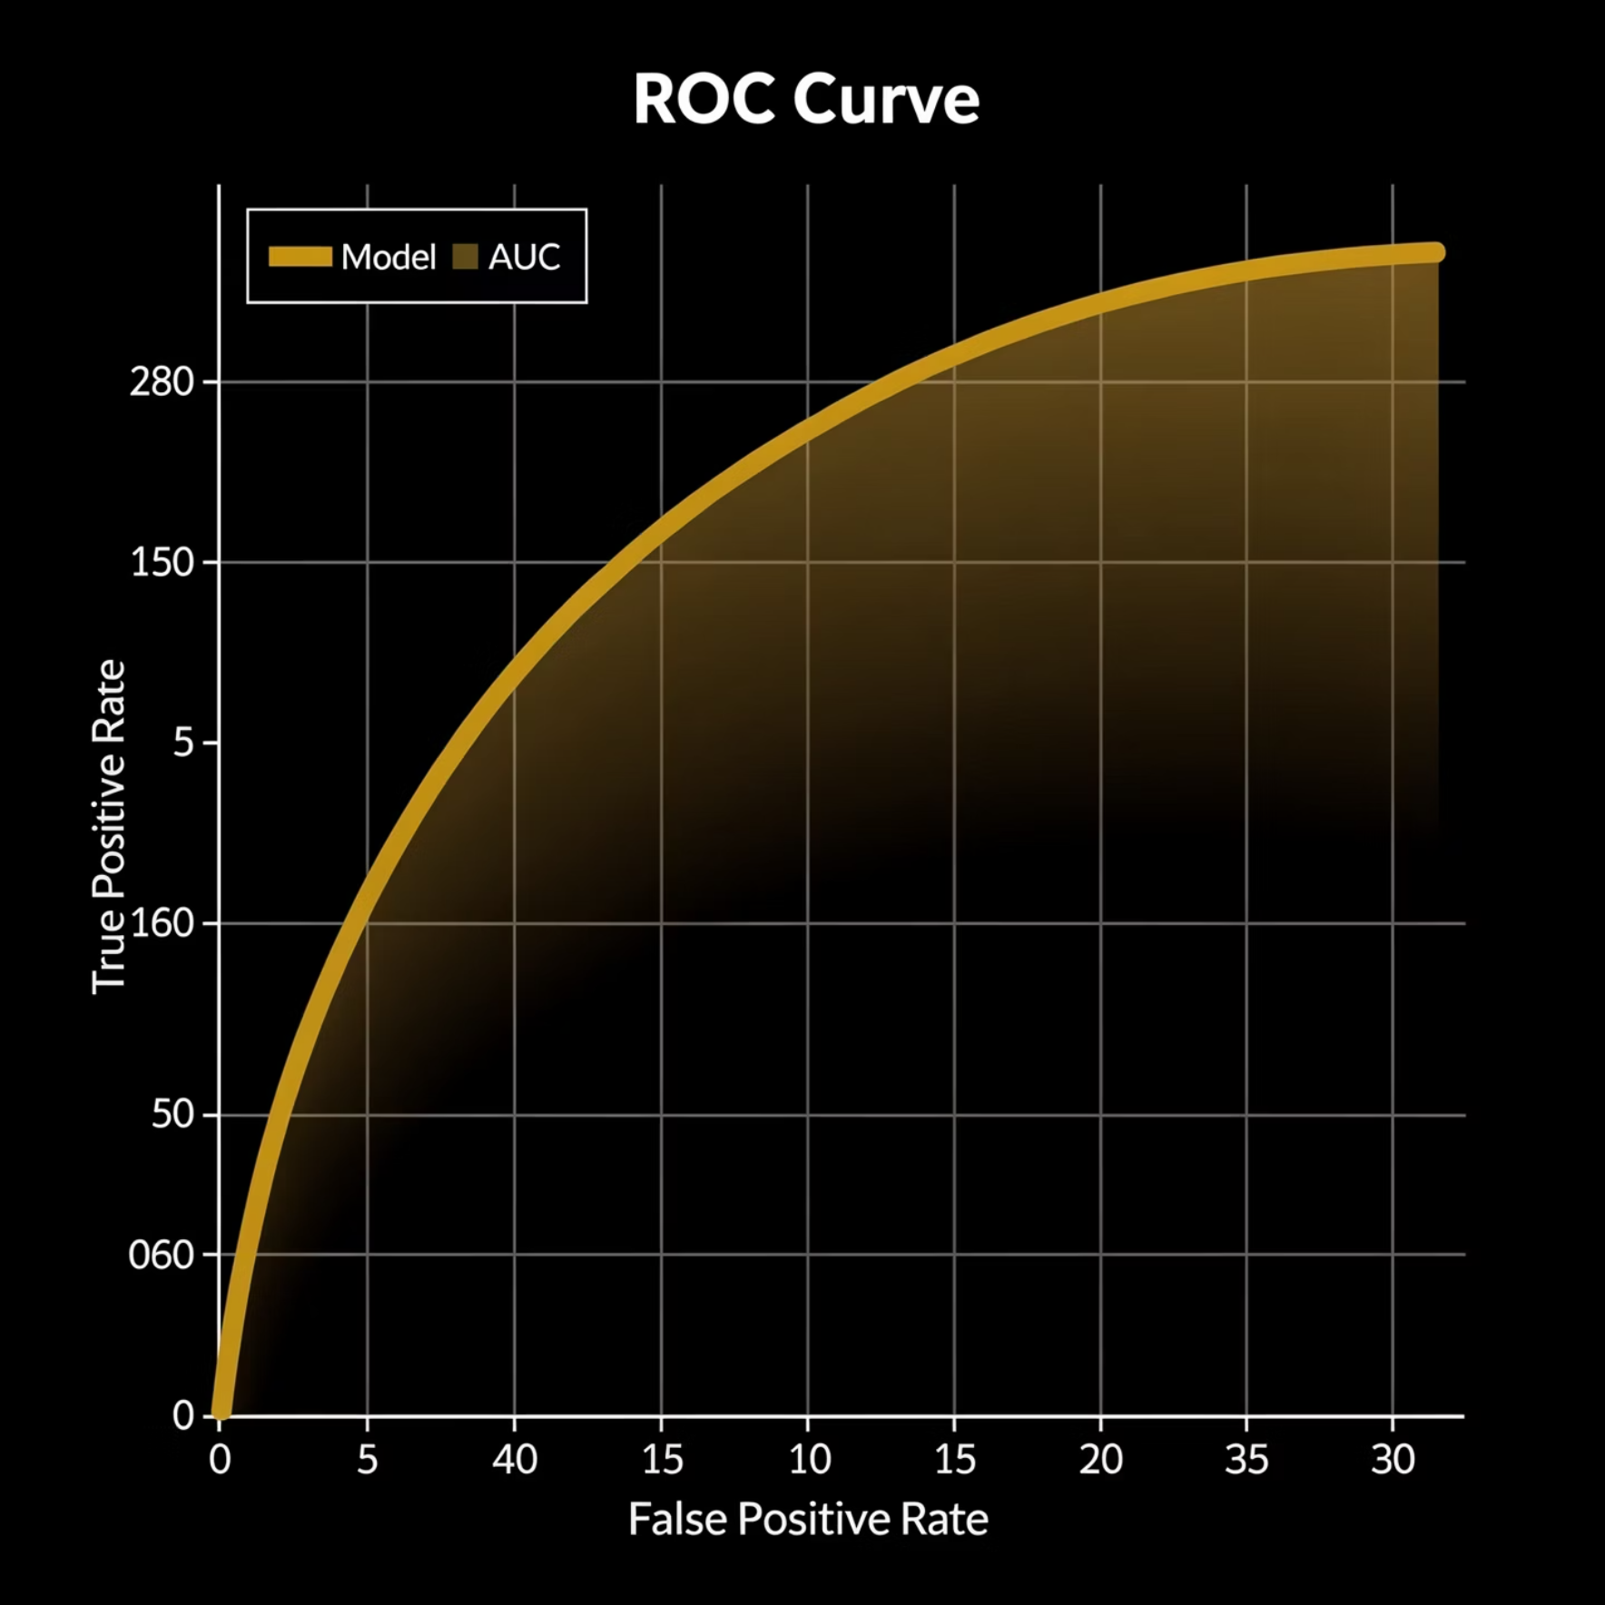
Confusion Matrix and ROC Curve
Confusion Matrix
ROC Curve and AUC
Predicted Positive
Predicted Negative
ROC Curve: Plots True Positive Rate vs False Positive Rate at various thresholds
Actual Positive
True Positive (TP)
False Negative (FN)
Diagonal line = random classifier
Curve closer to top-left = better
Actual Negative
False Positive (FP)
True Negative (TN)
AUC (Area Under Curve):
Visualizes classification performance across all classes. Shows types of errors made by model.
AUC = 1: Perfect classifier
AUC = 0.5: Random classifier
AUC = 0: Worst classifier

Slide 27
Algorithm Comparison
Algorithm
Type
Advantages
Disadvantages
Best Use
Decision Tree
Both
Interpretable, handles mixed data, no scaling needed
Prone to overfitting, unstable with small changes
Interpretability needed
KNN
Both
Simple, no training phase, non-parametric
Slow prediction, memory intensive, sensitive to scale
Small datasets
SVM
Both
Effective in high dimensions, memory efficient
Slow training, kernel selection challenging
Text classification
Linear Regression
Regression
Simple, fast, interpretable
Assumes linearity, sensitive to outliers
Linear relationships
Logistic Regression
Classification
Probabilistic output, fast, interpretable
Assumes linear decision boundary
Binary classification

Slide 28
Real-World Applications
Decision Trees
K-Nearest Neighbors
Support Vector Machine
Customer churn prediction in telecom, credit risk assessment in banking, medical diagnosis systems, fraud detection in finance, and loan approval decisions.
Recommender systems for e-commerce, image recognition and classification, pattern recognition in biometrics, anomaly detection in cybersecurity.
Text classification and sentiment analysis, face detection in security systems, bioinformatics for protein classification, handwriting recognition in OCR.
Linear Regression
Logistic Regression
House price prediction in real estate, sales forecasting for businesses, stock price analysis, weather temperature prediction.
Email spam filtering, disease prediction in healthcare, customer conversion prediction in marketing, credit default prediction in finance.

Slide 29
Python Implementation Tips
1
2
Import Libraries
Prepare Data
from sklearn.tree import DecisionTreeClassifier
from sklearn.neighbors import KNeighborsClassifier
from sklearn.svm import SVC
from sklearn.linear_model import LinearRegression, LogisticRegression
from sklearn.model_selection import train_test_split
from sklearn.metrics import accuracy_score, mean_squared_error
X_train, X_test, y_train, y_test = train_test_split(
X, y, test_size=0.3, random_state=42)
# Scale features if needed
from sklearn.preprocessing import StandardScaler
scaler = StandardScaler()
X_train_scaled = scaler.fit_transform(X_train)
3
4
Train Model
Evaluate Performance
model = DecisionTreeClassifier(max_depth=5)
# or KNeighborsClassifier(n_neighbors=5)
# or SVC(kernel='rbf', C=1.0)
model.fit(X_train, y_train)
y_pred = model.predict(X_test)
accuracy = accuracy_score(y_test, y_pred)
print(f"Accuracy: {accuracy:.3f}")
# Use appropriate metrics for your task

Slide 30
Key Takeaways
Decision Trees
KNN
Intuitive and interpretable but prone to overfitting. Use pruning techniques and ensemble methods for better performance.
Simple lazy learner sensitive to K value and feature scaling. Best for small datasets with clear patterns.
SVM
Linear Regression
Powerful for complex boundaries using kernel trick. Requires careful hyperparameter tuning for optimal results.
Foundation for regression tasks assuming linear relationships. Fast and interpretable for continuous predictions.
Logistic Regression
Evaluation
Go-to algorithm for binary classification providing probability outputs. Simple yet effective for many tasks.
Choose metrics based on problem type and business requirements. Balance multiple metrics for comprehensive assessment.

