Slide 1

Unsupervised Learning Algorithms
Complete Diploma Notes for Machine Learning
MSBTE K-Scheme | Course Code: 316316 | Semester 6

Slide 2
What is Unsupervised Learning?
Unsupervised learning is a type of machine learning where algorithms learn patterns from unlabeled data without human supervision. Unlike supervised learning, there's no target variable to predict—the algorithm discovers hidden structures on its own.
No Labels
Works with unlabeled data
This approach is particularly valuable for exploratory data analysis, customer segmentation, anomaly detection, and dimensionality reduction tasks where labeled data is unavailable or expensive to obtain.
Pattern Discovery
Finds hidden structures
Exploratory
Understands data distribution

Slide 3
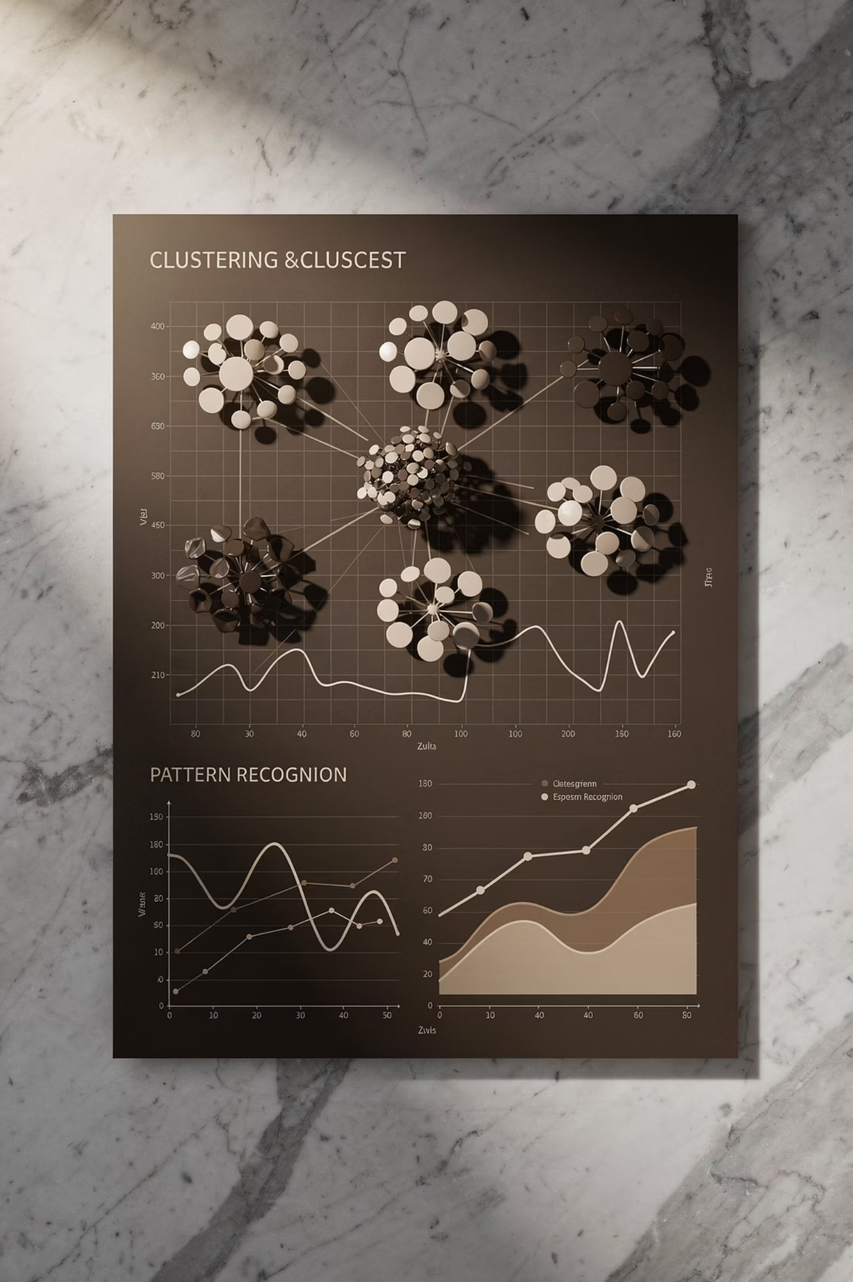

Types of Unsupervised Learning
Clustering
Groups similar data points together based on their characteristics. Common algorithms include K-Means, Hierarchical Clustering, and DBSCAN.
Dimensionality Reduction
Reduces the number of features while preserving important information. Techniques include PCA, t-SNE, and Autoencoders.
Association Rules
Discovers relationships between variables in large datasets. Used in market basket analysis with algorithms like Apriori.

Slide 4
Real-World Applications
1
Customer Segmentation
2
Anomaly Detection
Businesses use clustering to group customers by purchasing behavior, demographics, and preferences for targeted marketing campaigns.
Identify unusual patterns in network traffic, financial transactions, or manufacturing processes to detect fraud or defects.
3
Recommendation Systems
4
Image Compression
Platforms like Netflix and Amazon use unsupervised learning to discover user preferences and suggest relevant content.
Reduce image file sizes while maintaining visual quality using dimensionality reduction techniques like PCA.

Slide 5

K-Means Clustering
K-Means is one of the most popular clustering algorithms that partitions data into K clusters based on similarity. It aims to minimize the within-cluster sum of squares (WCSS), also known as inertia.
The algorithm works iteratively by assigning points to the nearest centroid and updating centroids based on cluster means until convergence is reached.

Slide 6
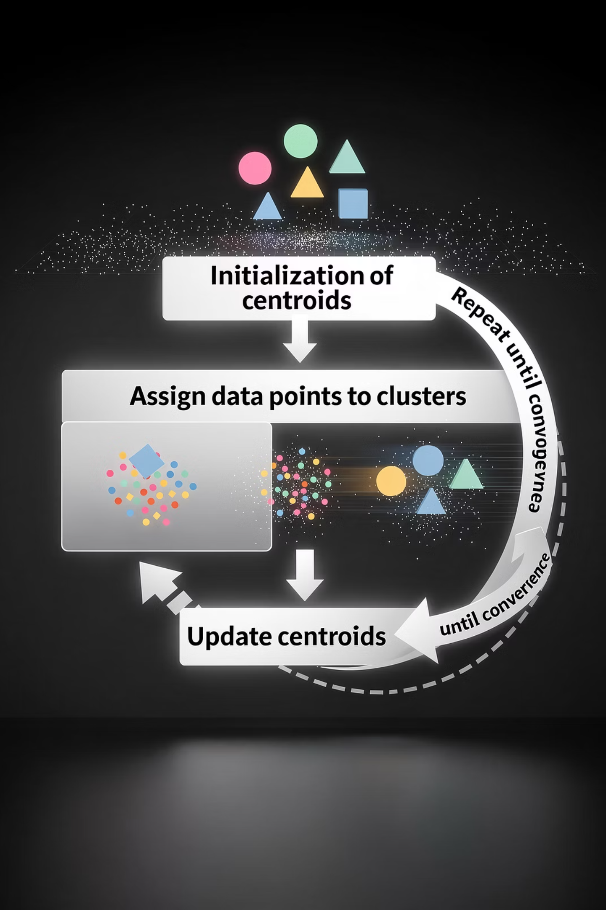
How K-Means Works
1
Initialize Centroids
Choose K random points from the dataset as initial cluster centroids
2
Assign Clusters
Assign each data point to the nearest centroid based on Euclidean distance
3
Update Centroids
Calculate new centroids as the mean of all points in each cluster
4
Repeat Until Convergence
Continue steps 2-3 until centroids stabilize or maximum iterations reached

Slide 7


K-Means Objective Function
K-Means minimizes the Within-Cluster Sum of Squares (WCSS):
Where:
xi: Individual data points
μj: Cluster centroids
K: Number of clusters
Cj: Set of points in cluster j

Slide 8

Choosing the Optimal K Value
1
Elbow Method
Plot WCSS versus K and look for the "elbow" point where WCSS decreases slowly. This indicates the optimal number of clusters.
2
Silhouette Analysis
Measures how similar points are to their own cluster versus other clusters. Values range from -1 to +1, with higher values indicating better clustering.
3
Gap Statistics
Compares within-cluster dispersion to a reference distribution. Choose K where the gap statistic is maximum.

Slide 9
K-Means Python Implementation
Here's a complete example of implementing K-Means clustering using scikit-learn:
from sklearn.cluster import KMeans
from sklearn.datasets import make_blobs
import matplotlib.pyplot as plt
# Generate sample data
X, y_true = make_blobs(n_samples=300, centers=4,
cluster_std=0.60, random_state=42)
# Apply K-Means
kmeans = KMeans(n_clusters=4, random_state=42, n_init=10)
y_kmeans = kmeans.fit_predict(X)
# Plot results
plt.scatter(X[:, 0], X[:, 1], c=y_kmeans, cmap='viridis')
plt.scatter(kmeans.cluster_centers_[:, 0],
kmeans.cluster_centers_[:, 1],
s=300, c='red', marker='X', label='Centroids')
plt.legend()
plt.show()
print("Inertia (WCSS):", kmeans.inertia_)

Slide 10

Hierarchical Clustering
Hierarchical clustering builds a hierarchy of clusters by either merging smaller clusters (agglomerative) or splitting larger ones (divisive). Unlike K-Means, it doesn't require specifying the number of clusters beforehand.
The result is a tree-like structure called a dendrogram that shows the relationships between clusters at different levels of granularity.

Slide 11
Agglomerative vs Divisive Clustering
Agglomerative (Bottom-Up)
Divisive (Top-Down)
Start with each point as a single cluster
Start with all points in one cluster
Find the closest pair of clusters
Find the cluster to split
Merge them into one cluster
Split it into two clusters
Repeat until desired number of clusters
Repeat until desired number of clusters

Slide 12

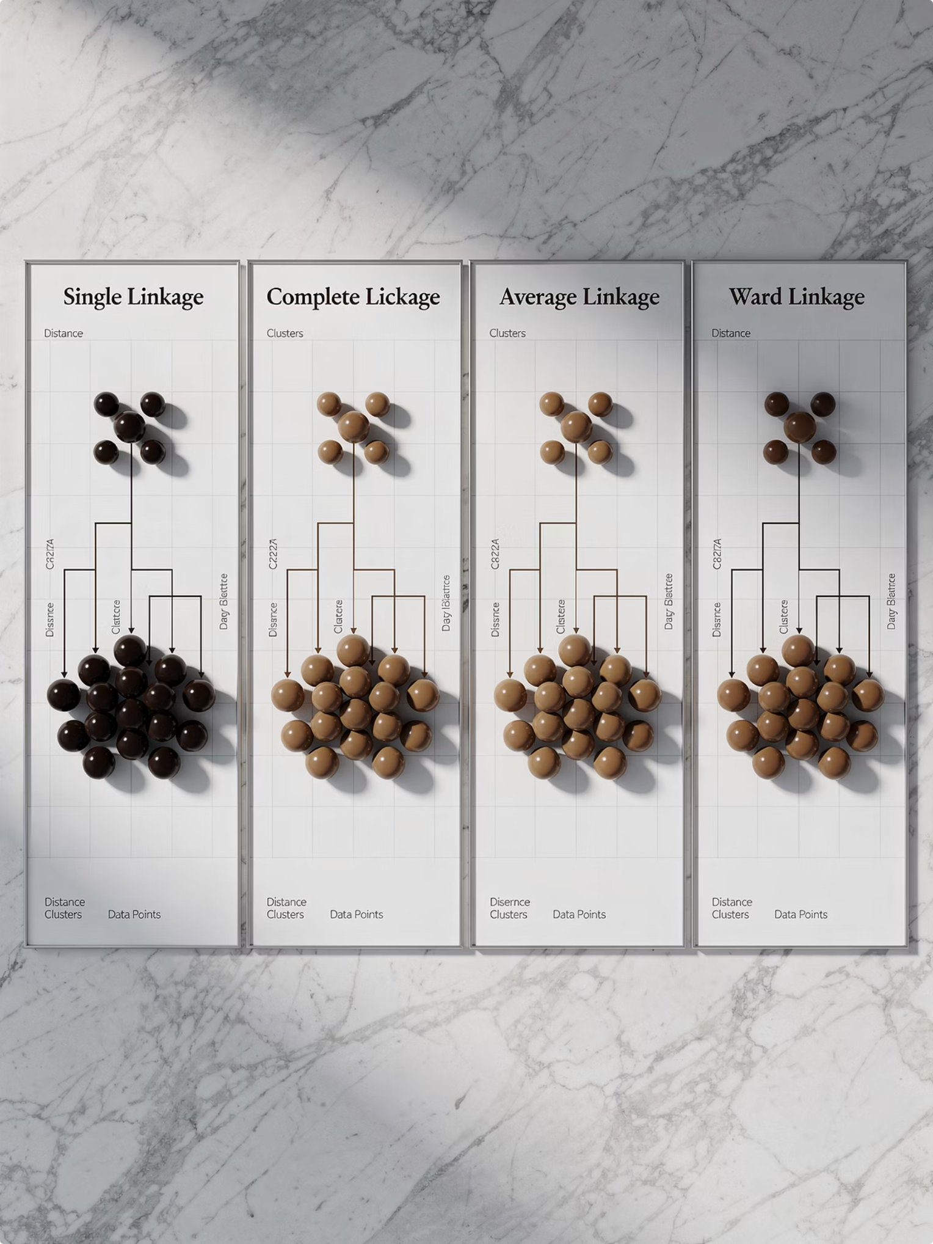
Linkage Methods in Hierarchical Clustering
1
Single Linkage
Distance between closest points of clusters. Tends to create long, chain-like clusters. Good for elongated shapes but sensitive to noise.
2
Complete Linkage
Distance between farthest points of clusters. Creates compact, spherical clusters but sensitive to outliers.
3
Average Linkage
Average distance between all pairs of points. Balanced approach between single and complete linkage methods.
4
Ward's Method
Minimizes within-cluster variance. Similar to K-Means objective, produces compact clusters.

Slide 13

Understanding Dendrograms
A dendrogram is a tree-like diagram that shows the hierarchical relationships between clusters. It's a powerful visualization tool for understanding cluster structure.
Reading a Dendrogram:
Height of merge indicates similarity/distance
Cutting a horizontal line gives clusters
Y-axis shows distance or similarity measure
Branches show cluster relationships

Slide 14
Hierarchical Clustering Implementation
Python code for agglomerative clustering with dendrogram visualization:
from sklearn.cluster import AgglomerativeClustering
from scipy.cluster.hierarchy import dendrogram, linkage
import matplotlib.pyplot as plt
# Generate sample data
X, y_true = make_blobs(n_samples=150, centers=3,
cluster_std=0.60, random_state=42)
# Apply hierarchical clustering
hierarchical = AgglomerativeClustering(n_clusters=3,
linkage='ward')
y_hierarchical = hierarchical.fit_predict(X)
# Create and plot dendrogram
linkage_matrix = linkage(X, method='ward')
plt.figure(figsize=(12, 8))
dendrogram(linkage_matrix, truncate_mode='level', p=5)
plt.xlabel('Sample index')
plt.ylabel('Distance')
plt.title('Hierarchical Clustering Dendrogram')
plt.show()

Slide 15

Clustering Evaluation Metrics
Evaluating clustering quality is crucial for understanding algorithm performance. We use two types of metrics: internal metrics (when true labels are unknown) and external metrics (when true labels are available).

Slide 16


Internal Evaluation Metrics
1
WCSS (Inertia)
2
Calinski-Harabasz Index
3
Davies-Bouldin Index
Measures cluster compactness. Lower values indicate tighter, more cohesive clusters.
Average similarity between clusters. Lower values indicate better separation between clusters.
Ratio of between-cluster to within-cluster dispersion. Higher values indicate better clustering.

Slide 17


Silhouette Analysis
The silhouette coefficient measures how similar a point is to its own cluster compared to other clusters:
Where:
a(i): Average distance to points in same cluster
b(i): Average distance to points in nearest cluster
Interpretation:
s(i) ≈ 1: Well-clustered point
s(i) ≈ 0: On cluster boundary
s(i) ≈ -1: Possibly wrong cluster

Slide 18
External Evaluation Metrics
1
Perfect Score
2
Good Score
3
Excellent
Adjusted Rand Index at maximum
Adjusted Mutual Information threshold
V-Measure for homogeneity
External metrics compare predicted clusters to true labels. Adjusted Rand Index (ARI) measures similarity between clusterings, while Adjusted Mutual Information (AMI) measures agreement. V-Measure combines homogeneity and completeness scores.

Slide 19
Evaluation Metrics Implementation
from sklearn.metrics import (silhouette_score,
calinski_harabasz_score, adjusted_rand_score,
adjusted_mutual_info_score, v_measure_score)
# Internal metrics (no true labels needed)
silhouette = silhouette_score(X, y_pred)
ch_score = calinski_harabasz_score(X, y_pred)
inertia = kmeans.inertia_
print("=== Internal Metrics ===")
print(f"Silhouette Score: {silhouette:.3f}")
print(f"Calinski-Harabasz: {ch_score:.3f}")
print(f"Inertia (WCSS): {inertia:.3f}")
# External metrics (when true labels available)
ari = adjusted_rand_score(y_true, y_pred)
ami = adjusted_mutual_info_score(y_true, y_pred)
v_measure = v_measure_score(y_true, y_pred)
print("\n=== External Metrics ===")
print(f"Adjusted Rand Index: {ari:.3f}")
print(f"Adjusted Mutual Info: {ami:.3f}")
print(f"V-Measure: {v_measure:.3f}")

Slide 20

Principal Component Analysis (PCA)
Principal Component Analysis (PCA) is a powerful dimensionality reduction technique that transforms high-dimensional data into a lower-dimensional space while preserving as much variance as possible.
PCA identifies principal components—directions of maximum variance in the data—and projects the data onto these components.

Slide 21





Mathematical Foundation of PCA
Covariance Matrix
Eigenvalue Decomposition
Explained Variance
Calculate covariance between features
Find eigenvalues and eigenvectors
Proportion of variance captured

Slide 22
PCA Implementation Steps
1
Standardize Data
Scale features to mean=0, variance=1 to ensure equal contribution
2
Compute Covariance Matrix
Calculate relationships between features
3
Calculate Eigenvalues
Find principal component directions and magnitudes
4
Sort Components
Order by eigenvalues (descending)
5
Select Top K
Choose components capturing desired variance
6
Transform Data
Project onto new basis vectors

Slide 23
PCA Python Implementation
Complete example of PCA for dimensionality reduction:
from sklearn.decomposition import PCA
from sklearn.datasets import load_digits
import matplotlib.pyplot as plt
# Load digits dataset (64 features)
digits = load_digits()
X = digits.data
y = digits.target
print("Original shape:", X.shape) # (1797, 64)
# Apply PCA to reduce to 2 dimensions
pca = PCA(n_components=2)
X_pca = pca.fit_transform(X)
print("PCA shape:", X_pca.shape) # (1797, 2)
print("Explained variance:", pca.explained_variance_ratio_)
print("Total variance:", sum(pca.explained_variance_ratio_))
# Visualize results
plt.figure(figsize=(10, 8))
scatter = plt.scatter(X_pca[:, 0], X_pca[:, 1],
c=y, cmap='tab10', alpha=0.7)
plt.colorbar(scatter)
plt.xlabel('First Principal Component')
plt.ylabel('Second Principal Component')
plt.title('PCA of Digits Dataset')
plt.show()

Slide 24

Choosing Number of Components
Determining the optimal number of principal components is crucial for balancing dimensionality reduction with information preservation.
Common Approaches:
Cumulative Variance: Choose components that explain 95% of variance
Elbow Method: Look for elbow in scree plot
Kaiser Criterion: Keep components with eigenvalue > 1
Domain Knowledge: Based on application requirements

Slide 25



PCA Applications
Image Compression
Data Visualization
Noise Reduction
Reduce image storage requirements while maintaining visual quality by keeping only top principal components.
Project high-dimensional data to 2D or 3D for visualization and pattern discovery.
Remove noise by eliminating components with low variance that often represent random fluctuations.

Slide 26

Ethics in Machine Learning
As machine learning systems become increasingly integrated into society, ethical considerations are paramount. Responsible AI development requires addressing bias, ensuring fairness, protecting privacy, and maintaining transparency.
Ethical ML practices build trust, prevent harm, and ensure technology benefits all members of society equitably.

Slide 27
Bias and Fairness in ML
1
Selection Bias
2
Confirmation Bias
3
Algorithmic Bias
Training data doesn't represent the real-world population, leading to skewed predictions for underrepresented groups.
Models reinforce existing beliefs or stereotypes present in historical data, perpetuating discrimination.
Model design or optimization choices inadvertently favor certain groups over others in outcomes.
Fairness metrics include demographic parity (equal positive outcomes across groups), equal opportunity (equal true positive rates), and equalized odds (equal TPR and FPR across groups).

Slide 28

Privacy and Data Protection
Key Privacy Concerns:
Regulatory Frameworks:
Data Collection: Informed consent and transparency about data usage
GDPR: General Data Protection Regulation (EU)
CCPA: California Consumer Privacy Act
Data Storage: Secure storage and appropriate retention policies
HIPAA: Health Insurance Portability Act
Data Usage: Purpose limitation and minimal data collection
Data Minimization: Collect only necessary data
Data Sharing: Controlled access and anonymization

Slide 29




Transparency and Explainability
Model Transparency
Explainable AI
Clear documentation of model architecture and training process
Techniques like SHAP and LIME to interpret predictions
User Understanding
Feature Importance
Communicating results in accessible language
Understanding which features drive model decisions

Slide 30

Model Deployment and Production
Deploying machine learning models to production requires careful planning, robust infrastructure, and ongoing monitoring. The deployment process transforms research code into reliable, scalable systems that serve real users.

Slide 31
Model Serialization
Using Pickle:
Using Joblib (Recommended):
import pickle
# Save model
with open('model.pkl', 'wb') as f:
pickle.dump(model, f)
# Load model
with open('model.pkl', 'rb') as f:
loaded_model = pickle.load(f)
from joblib import dump, load
# Save model
dump(model, 'model.joblib')
# Load model
loaded_model = load('model.joblib')
Joblib is preferred for large models as it's more efficient with NumPy arrays and provides better compression.

Slide 32
Creating ML APIs with Flask
Flask enables easy creation of REST APIs for model serving:
from flask import Flask, request, jsonify
import joblib
import numpy as np
app = Flask(__name__)
model = joblib.load('model.joblib')
@app.route('/predict', methods=['POST'])
def predict():
try:
# Get data from request
data = request.get_json()
features = np.array(data['features']).reshape(1, -1)
# Make prediction
prediction = model.predict(features)
# Return result
return jsonify({
'prediction': prediction.tolist(),
'status': 'success'
})
except Exception as e:
return jsonify({
'error': str(e),
'status': 'error'
})
if __name__ == '__main__':
app.run(debug=True, host='0.0.0.0', port=5000)

Slide 33

Monitoring and Maintenance
1
Performance Monitoring
Track accuracy, latency, and throughput metrics continuously
2
Data Drift Detection
Monitor input distribution changes that affect predictions
3
Model Retraining
Periodic updates with new data to maintain performance
4
Version Control
Track model versions and enable rollback if needed

Slide 34
Key Takeaways
1
K-Means Clustering
2
Hierarchical Clustering
Simple and efficient for spherical clusters. Use elbow method or silhouette analysis to choose K. Best for large datasets with clear separation.
Builds cluster hierarchy without predefined K. Dendrograms visualize relationships. Better for small datasets and exploratory analysis.
3
PCA
4
Ethics & Deployment
Powerful dimensionality reduction preserving variance. Essential for visualization and preprocessing. Choose components explaining 95% variance.
Address bias, ensure fairness, protect privacy. Serialize models, create APIs, monitor performance. Responsible AI is crucial.

Slide 35

Exam Preparation Guide
Short Answer Topics:
Practical Questions:
Define unsupervised learning with examples
Implement K-Means on iris dataset
Create dendrogram for hierarchical clustering
Explain K-Means algorithm steps
Describe elbow method for choosing K
Apply PCA for dimensionality reduction
Compare agglomerative vs divisive clustering
Evaluate clustering using silhouette analysis
Explain silhouette coefficient interpretation
Serialize and deploy ML model
Calculate WCSS and explained variance
Define PCA and its applications
Discuss ethical concerns in ML
Remember: Practice coding examples, understand mathematical foundations, and focus on real-world applications. Master evaluation metrics and ethical considerations for comprehensive understanding.

